Slide 1
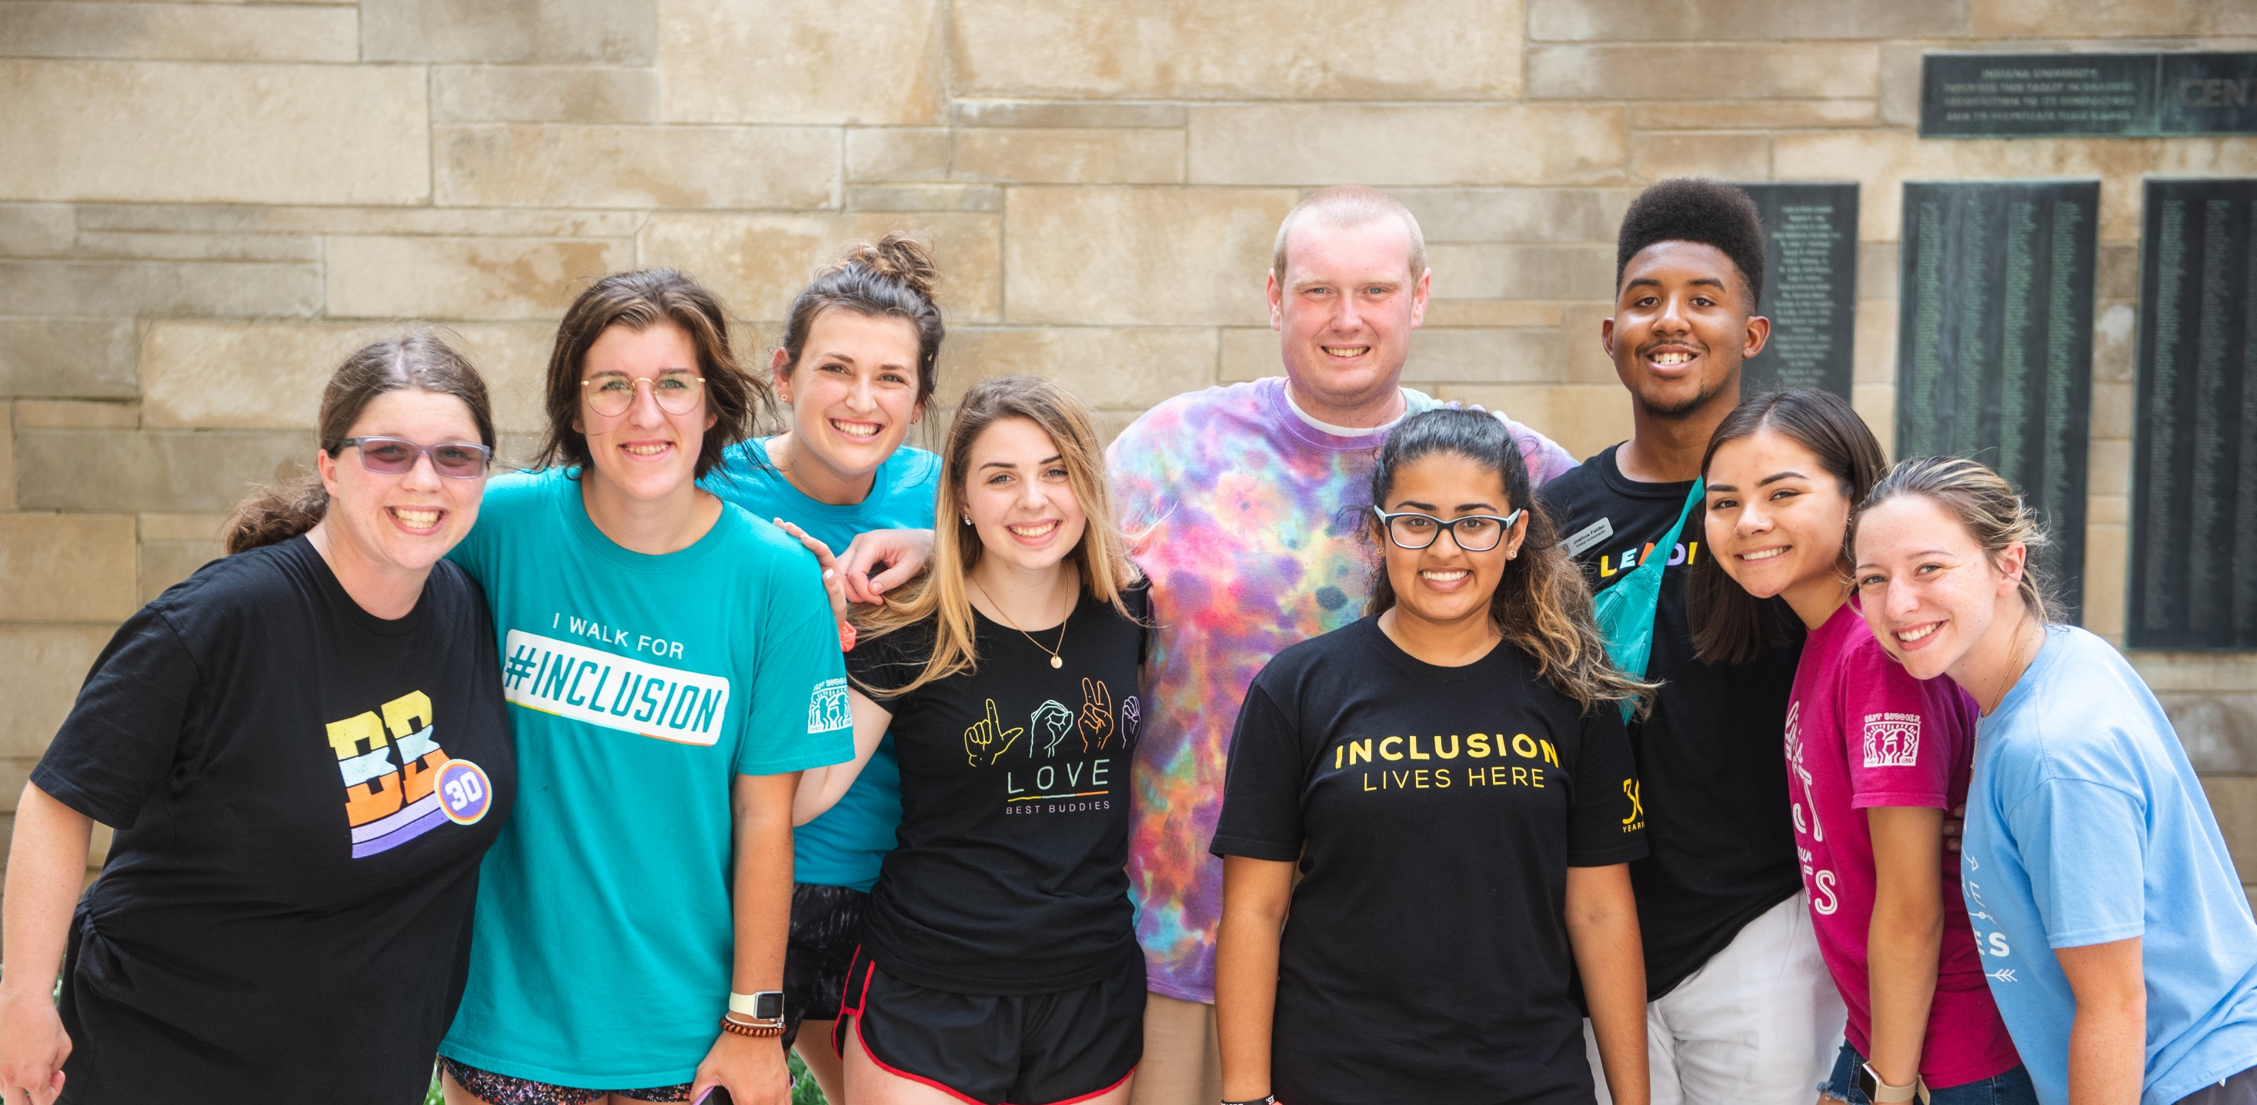
Best Buddies Ambassadors Training

Slide 2
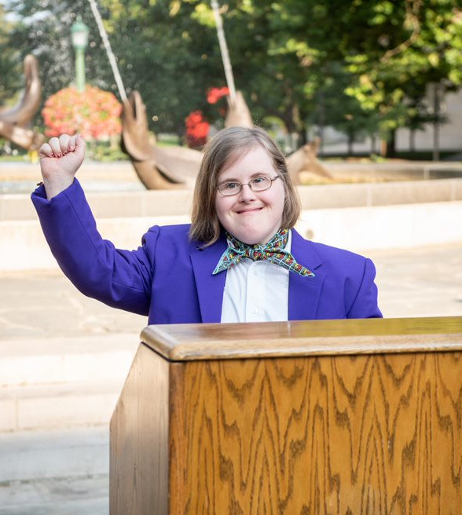

Welcome & Introductions
Tell us about yourself!
Name
How you’re involved in Best Buddies
[Ice Breaker Question]

Slide 3
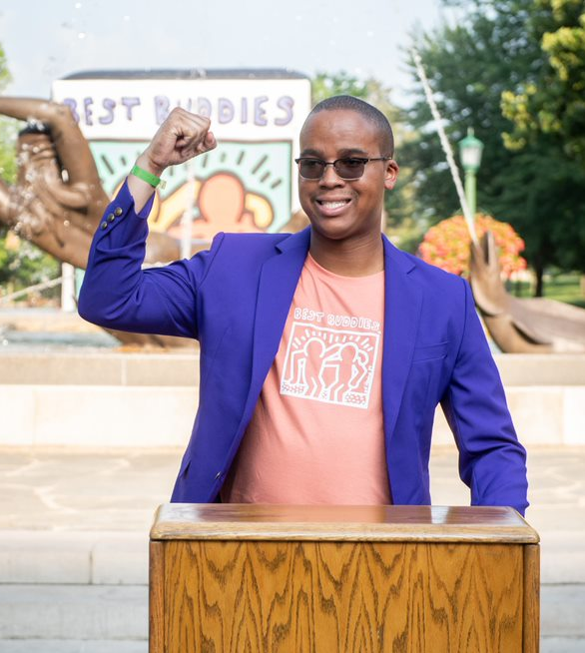

Goals for
Today’s Training
Learn more about Best Buddies’ mission and programs
Develop a speech that can be shared to raise awareness about inclusion
Use your voice and share your unique perspective
Get to know your fellow Ambassadors, staff and volunteers
Gain the skills and confidence to become an effective speaker

Slide 4


Before We Begin…
Please follow the following conversation norms to help us ensure that everyone feels respected and safe to share today.
Speak from the “I” perspective.​
Share the space. ​
Be respectful and consider all views.​
Listen for Understanding.​
Honor Confidentiality. ​
Stay Engaged. ​

Slide 5
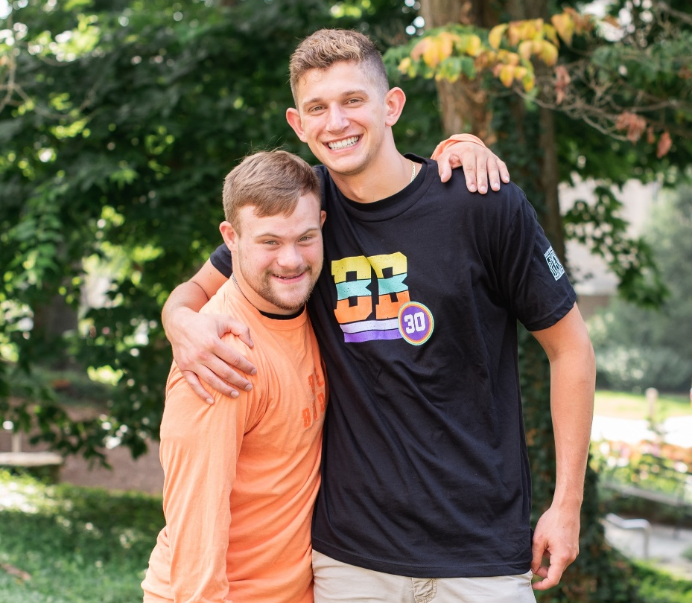
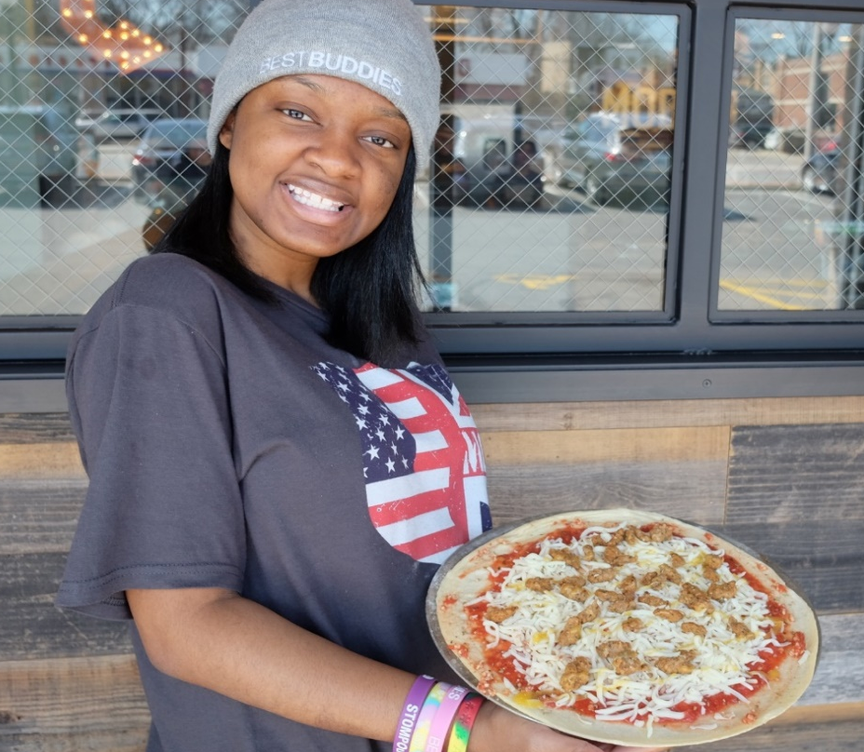
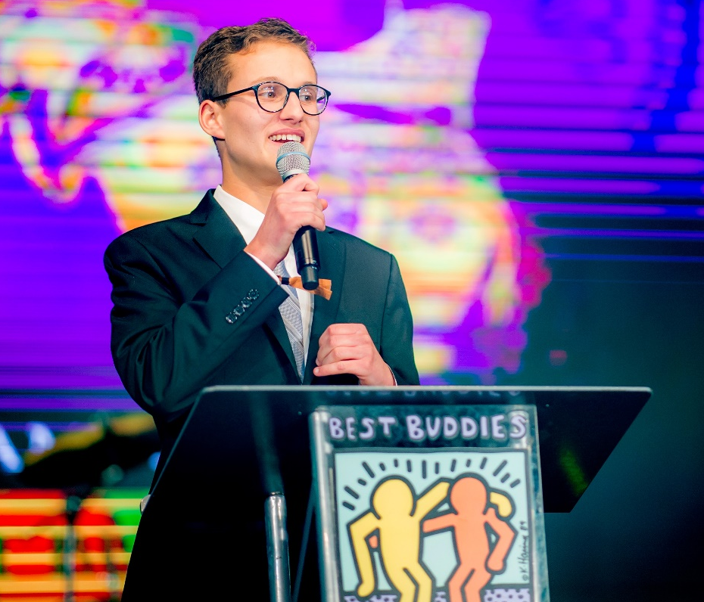
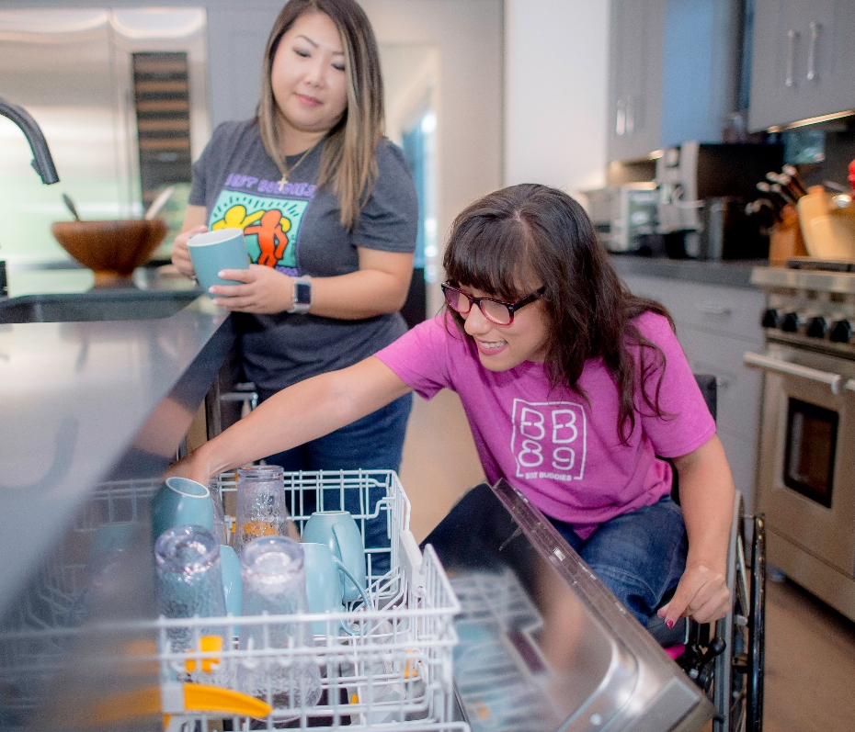
Who We Are
Best Buddies International is the world’s largest organization dedicated to ending the social, physical and economic isolation of the 200 million people with intellectual and developmental disabilities (IDD).
Mission
Best Buddies is dedicated to establishing a global volunteer movement that creates opportunities for one-to-one friendships, integrated employment, leadership development and inclusive living for people with IDD.
Who We Serve
The IDD community that Best Buddies serves includes, but is not limited to, people with Down syndrome, autism, fragile X syndrome, Williams syndrome, cerebral palsy, traumatic brain injury and other undiagnosed disabilities.

Slide 6
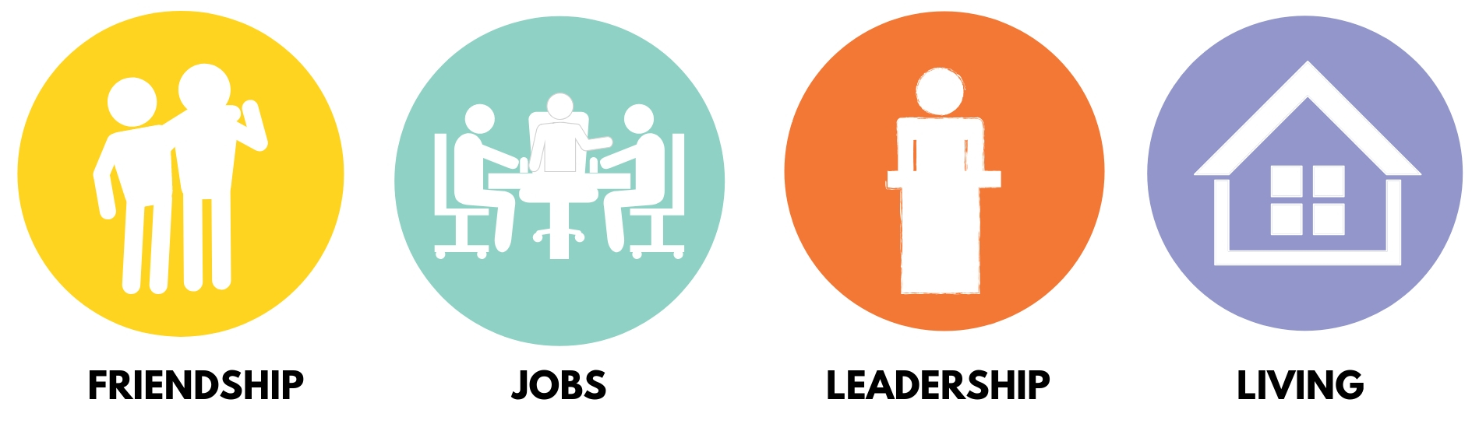
Be A Best Buddies Expert!
Get to know our mission pillars…
Fosters connections between people with and without IDD. This pillar includes our elementary through college level school chapters, our Citizens program for adults and our e-Buddies online community.
Secures and supports employment opportunities for people with IDD, allowing them to earn an income, pay taxes, and continuously and independently support themselves.
Educates and empowers people with and without IDD to become leaders, public speakers and advocates for inclusion. This pillar includes our Ambassador program as well as our Transition services.
Provides an inclusive living experience in which people with and without IDD are active, contributing citizens – living independently in a dynamic environment where they can learn, grow, and thrive.

Slide 7


Q: Who is Best Buddies’ founder?
Q: Which BB program builds public speaking skills?
A: Anthony Kennedy Shriver
A: Ambassadors
Q: What is Best Buddies’ sister organization?
Q: What school had the first Best Buddies Chapter?
A: Special Olympics
A: Georgetown University
Q: Which Best Buddies program matches adults in
one to one friendships?
Q: What year was Best Buddies founded?
A: 1989
A: Citizens
Q: Which artist created the Best Buddies logo?
Q: In what city & state is Best Buddies HQ?
A: Keith Haring
A: Miami, FL

Slide 8


Stay Up To Date
About Your State
As an Ambassador you play an important role in raising awareness about ways to get involved and bringing new people to Best Buddies’ mission. Below is a list of program options we are currently offering in [STATE NAME].
School Friendship
Citizens
e-Buddies
Ambassadors
Transitions
Jobs
Living
Encourage people to learn more by visiting our state website at www.bestbuddies.org/[STATE NAME].

Slide 9
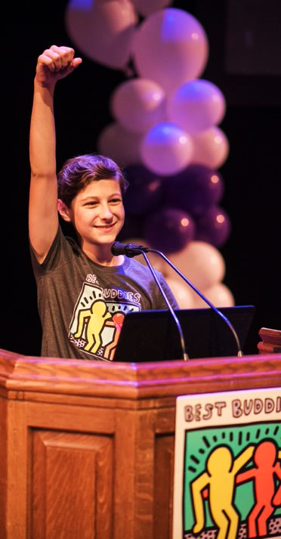
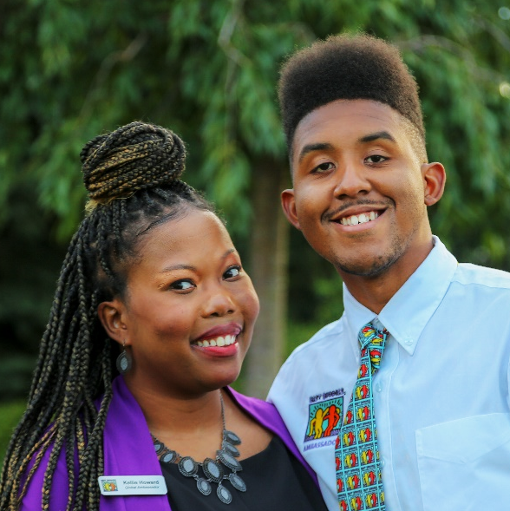
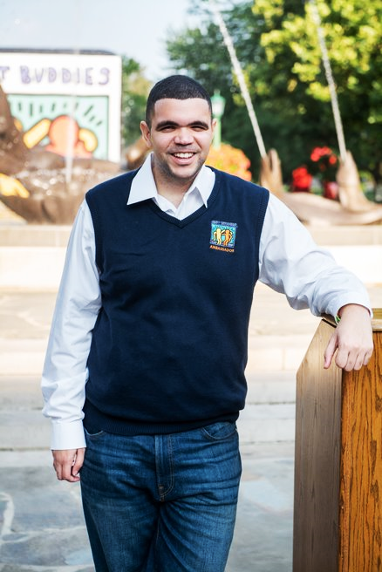
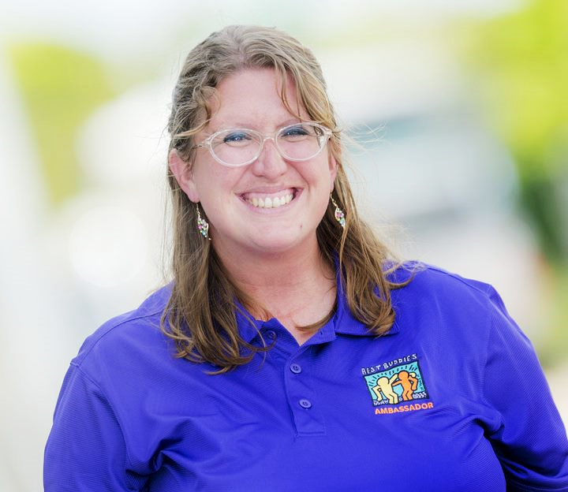
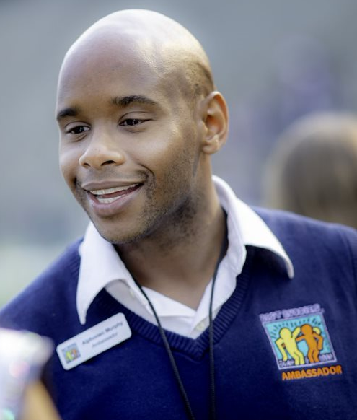
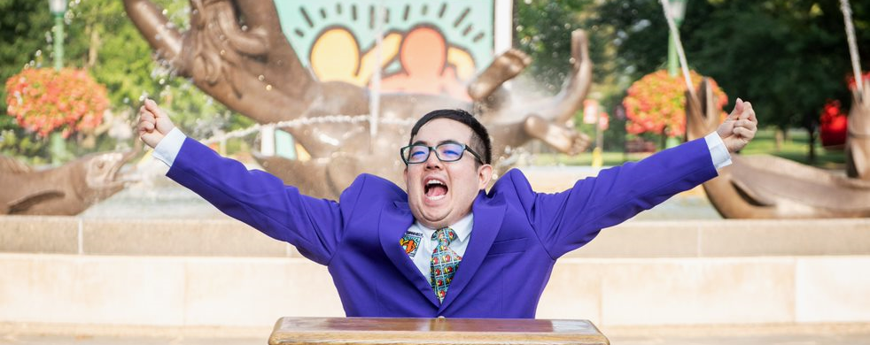
Ambassador Roles
Ambassador
A participant who has completed official Best Buddies Ambassador trainings and is committed to raising awareness about inclusion and Best Buddies mission.
State Ambassador
A trained Ambassador who has been identified by Best Buddies staff to represent the state at events and in the community.
State Ambassadors are expected to:
Attend at least 2 state trainings
Identify at least 4 speaking opportunities
Attend at least 3 Best Buddies events per year
Global Ambassador
A participant who has completed state and national trainings and has been invited to advocate and share their story at a national or international level.

Slide 10
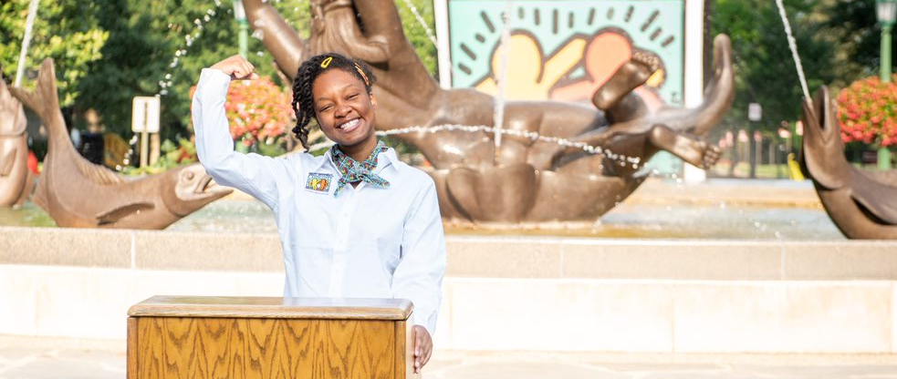

Group Discussion: The Power of Your Story
Why is it important to share your perspective?
What impact do you hope to make?

Slide 11
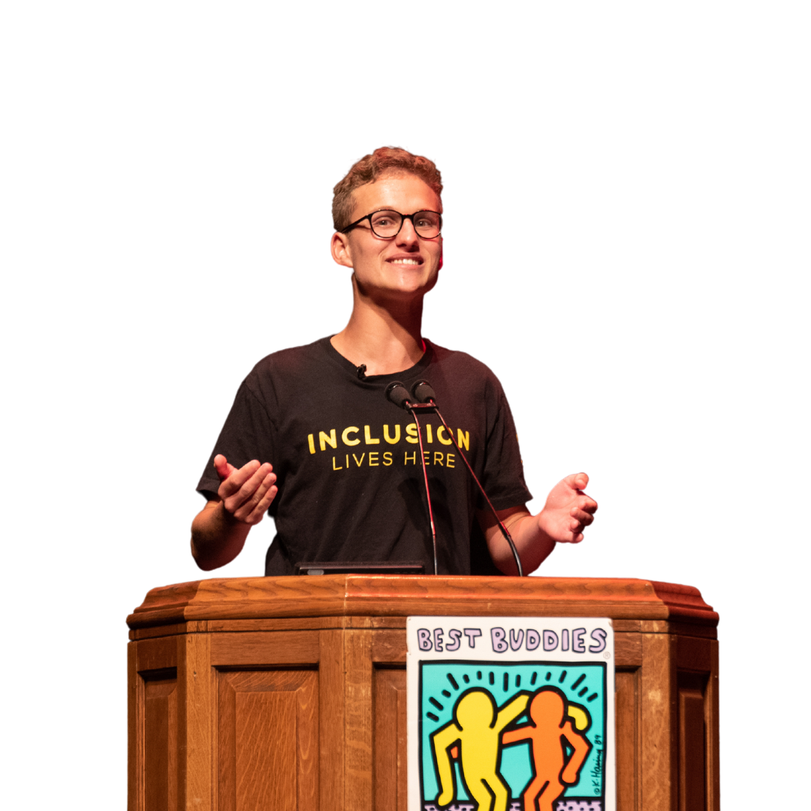

Meet Best Buddies Ambassador, Jack Mayor…
Jack’s life was forever changed when he was matched with his peer buddy, Josie. He shared
the story of their friendship in a speech at BBLC
in 2017. Here’s what he had to say about his Ambassador Training experience.
“I worked hard with speech coaches, practicing my speech over and over again. It felt like I was auditioning for the America Idol version for public speakers.
The coaches taught me when to inflect my voice, when to pause, when to be energetic, when to be emotional. They taught me how to engage my audience. They taught me to slow my pace and to wait for the applause to finish before I started speaking again. Most of all, they gave me the confidence I needed to get up here and speak in front of all of you now.”
You can check out Jack’s incredible speech, here.

Slide 12
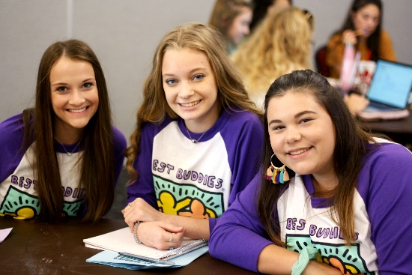
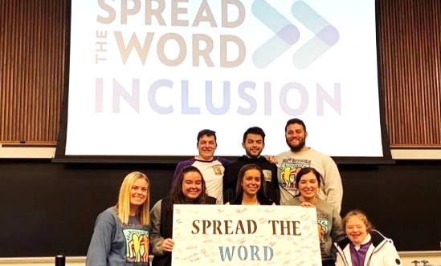

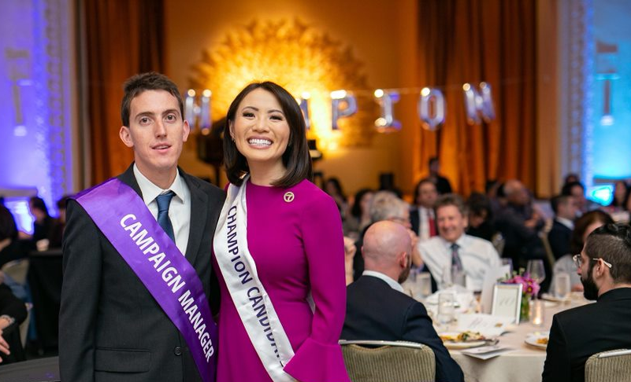
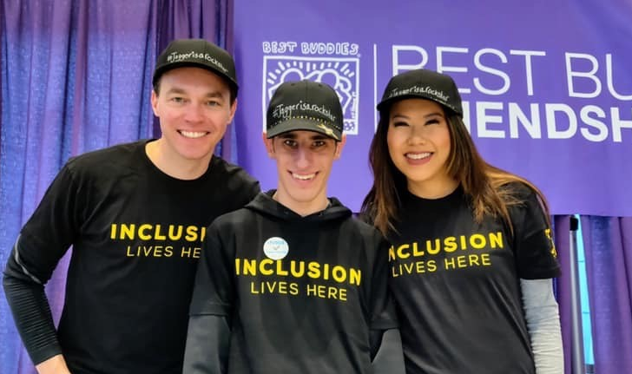
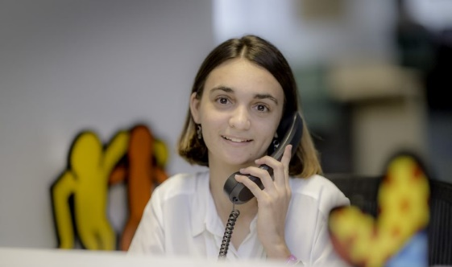
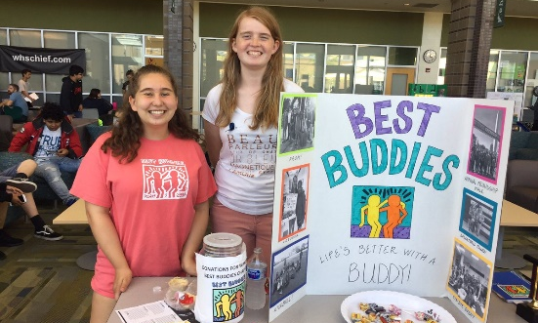
Speaking Engagements
As an Ambassador, there are a variety of ways that you can raise awareness about Best Buddies. When planning your speech, it is important to consider the type of event or meeting you are attending and think about who your audience will be. Below are some examples of opportunities to share our mission and your story with others.
School Chapter Events
Spread the Word Events
Corporate Meetings
Champion Galas
Friendship Walk
Everyday Conversations
Resource Fairs
Social Media

Slide 13
Perfecting Your Best Buddies Elevator Pitch
An Elevator Pitch is a brief message that helps to spark interest in your cause. It is handy to have one in mind when mingling at events, hosting a Best Buddies info table, or even if you’re just out and about sporting your Best Buddies gear.
Follow the steps below to craft your own Best Buddies Elevator Pitch!
03
What Makes
Us Unique?
Identify what sets Best Buddies apart from other organizations. Add your personal experience to gain credibility.
STEP 06
STEP 06
02
Explain the opportunity
Share about the mission, who we serve and how volunteers can get involved.
STEP 05
06
Practice, Practice.
Practice!
Get familiar with the messaging you develop so it’s easy to remember when you need it most and you can deliver it in a comfortable and authentic way.
STEP 04
01
Identify Goal
What are you hoping to get out of this conversation?
Example: Recruit new members, promote an event.
05
Bring It All Together
Once you’ve nailed down the elements of your pitch, edit down to keep it as concise as possible. Remember, you only have a few moments to keep your listener’s attention.
STEP 03
04
STEP 02
Engage with
A Question
Asking a (relevant) question provides your listener with an opportunity to participate in the conversation and can help you gauge their interest.
STEP 01

Slide 14
Planning Your Speech
Find Your
Mission Moment
Utilize the
Five W’s
Pick A Call To Action
How did you get involved in Best Buddies?​
What inspires you about being a part of Best Buddies?​
How has Best Buddies made a positive impact on your life?​
What do you want people to know about this mission?
When sharing your story, be sure to tell the audience
Who was involved
What happened
When and Where it occurred
and
Why it matters.
It’s important to identify what you want people to do once they’ve heard your speech.
Provide them with next steps they can take to get involved.
Here are a few examples:
Join the Citizens Program
Start a Walk team
Be kind to others

Slide 15
PARTS
OF A
SPEECH

Slide 16
INTRODUCTION
Your introduction should include all of the following:
  A thank you to the audience
  An introduction of yourself
  Your topic sentence
  An attention grabber like a question, joke or thought provoking statement
  Explain the Who, What, When, Where, Why

Slide 17

BODY
The body of the speech should include:
  At least 3 main points to support your topic sentence
  Facts about your subject
  Continuing your story from the introduction
  Tell your audience everything you want them to know

Slide 18
CONCLUSION
Your conclusion should include:
  A summary of your topic
  A call to action
  A thank you to the audience

Slide 19


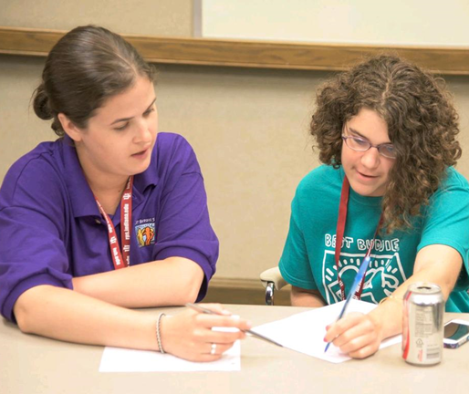
Time To Craft Your Speech!
Here are some reminders as you get started:
Start by identifying where and to whom you are speaking so your messaging can be geared toward your audience.
Discuss your ideas with your speech coach and determine what your goal is in giving this speech.
Use the companion worksheet to draft an outline of your speech.
Add more detail and review with your speech coach to finalize.
Be sure to include an attention grabber, your personal perspective and a call to action.
Try to keep an open mind when offered feedback.
Keep your speech brief- about 3 to 4 minutes in length. Practice reading it aloud to your speech coach to perfect your timing.

Slide 20
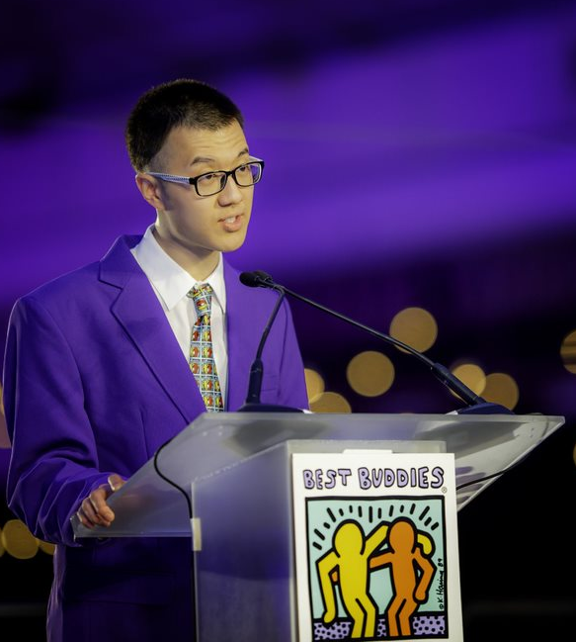




Prepare To Share
Tips for future speaking opportunities
Jot down the key points you want to make on note cards to help you stay on track when presenting
Try to memorize as much of your speech as you can so that you don’t have to rely on your notes
Practice your speech in front of a mirror to perfect your body language and eye contact when presenting
Keep track of your timing so that you can keep a steady pace and stay within the allotted time you have to speak

Slide 21

Ambassador Speech Presentations

Slide 22
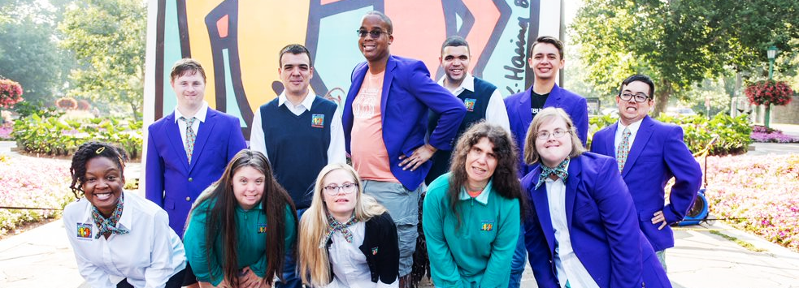
Thank you for being a Best Buddies Ambassador!
By sharing your story and raising awareness, you are helping to move our mission forward and create a more inclusive world!

Slide 23

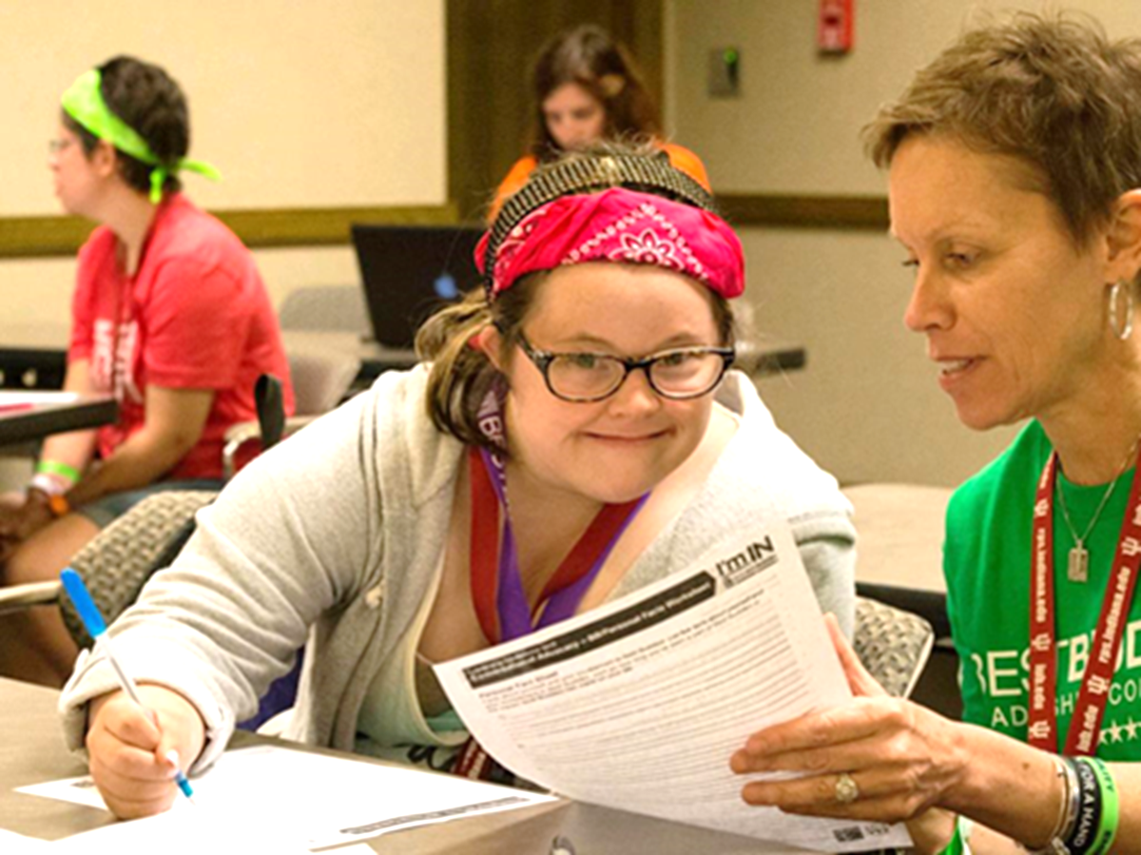
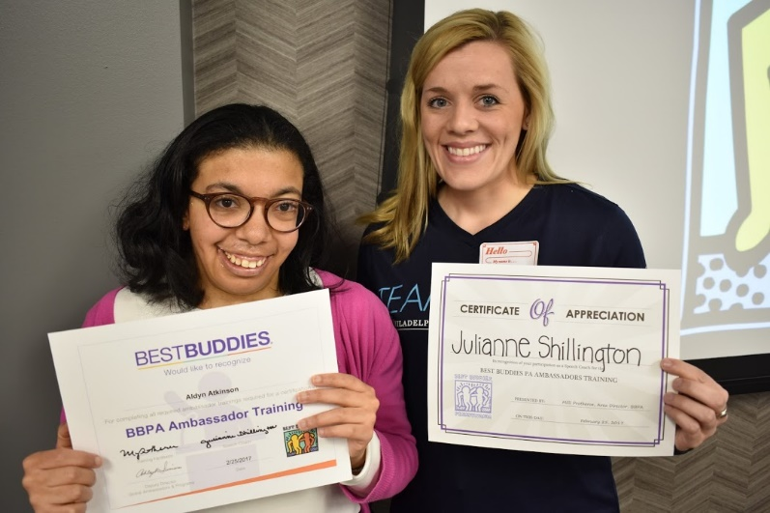
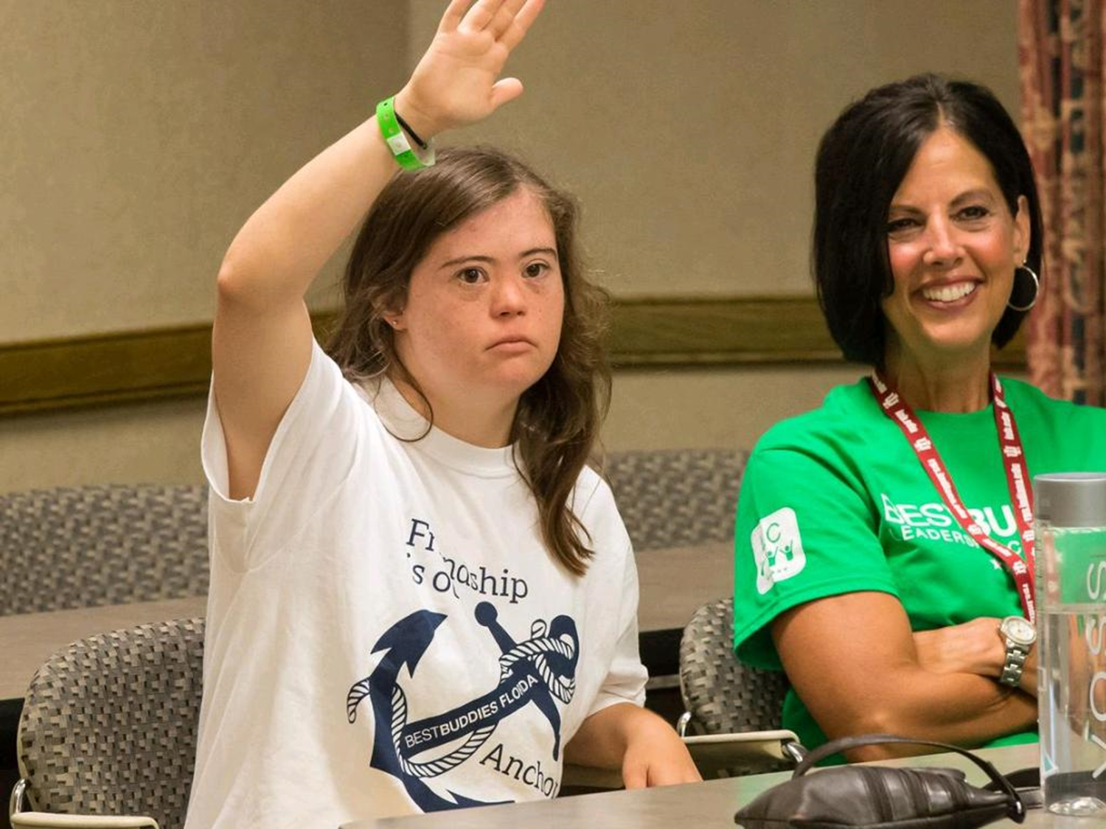
A big Best Buddies THANK YOU to our speech
coaches for their support of today’s training!

Slide 24
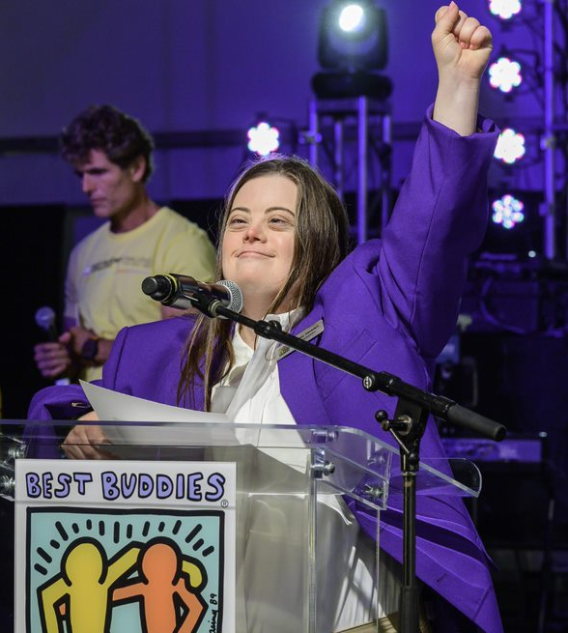
Keep in Touch
Your Subtitle Will Go Here
Best Buddies Office in State
Company Address
Phone
000-000-0000
e-Mail
namelast@bestbuddies.org
Visit Us
BESTBUDDIES.ORG
Notes:
Sample Contact Slide – Please update State Name, add address, phone number and e-mail +map picture on the right (it doesn’t have to be a map, it can be any pic if desired). Website link can be updated with “/state” or leave as is.
HOW TO CHANGE IMAGE – Click icon to add picture>Choose new image from desired location in your computer.
HOW TO CHANGE SHAPE COLORS – Double click desired shape> Go to shape format (button at top bar)>Click shape fill>Choose desired Best Buddies theme color.
HOW TO CHANGE TEXT COLORS – Double click desired text> Go to shape format (button at top bar)>Click text fill>Choose desired Best Buddies theme color.

Slide 25
MAKE A FRIEND | DONATE | VOLUNTEER
BESTBUDDIES.ORG

