Slide 1
DAY 1

Slide 2
TRAINING PURPOSE:
-LEARN WHAT IT MEANS TO BE A BB AMBASSADOR
-UPDATE AND REFINE SPEECHES
-HOW TO PRESENT A SPEECH EFFECTIVELY

Slide 3
GOALS AND RULES:
WHAT DO YOU HOPE TO ACCOMPLISH DURING THIS TRAINING? HOW DO YOU HOPE TO GROW?
TRY YOUR BEST
LISTEN WHILE OTHERS ARE SPEAKING
ASK FOR HELP
& HAVE FUN!!

Slide 4
ADVOCACY & FINDING YOUR FOCUS

Slide 5
PARTS OF A SPEECH RECAP:
INTRODUCTION
BODY
CONCLUSION
Notes:
Anatomy of a Speech:
Objective: To review the ambassador’s speech to make sure it has a beginning, middle and end.
What does it mean to edit?
Editing your speech allows you to make your message clearer, for yourself and for the audience. It gives you a chance to make sure that you are telling the audience exactly what you want them to know.
REVIEW: Begin by introducing the anatomy of a speech. Each speech is broken down into:
Intro: Who I am, what I want to share, and why you should care – with a hook!
Body: Three points explaining the purpose of my speech
Conclusion: Review the goals/purpose of the speech and “call to action” – what should the audience do with the information you shared?

Slide 6
THE FIVE Ws
WHO
WHAT
WHEN
WHERE
WHY

Slide 7
CREATING A HOOK:
-ASK THE AUDIENCE A RHETORICAL QUESTION
-ADD A JOKE OR SOMETHING FUNNY ABOUT YOURSELF (KEEP IT APPROPRIATE!)
-SURPRISE THE AUDIENCE
-TELL A STORY OR SHARE A MEMORY
-USE A QUOTE
-KEEP IT INTERACTIVE

Slide 8
FOLLOW UP ACTIVITIES
DAY 1
-FIVE W’s WORKSHEET
-HOW TO EDIT YOUR SPEECH WORKSHEET
EMAIL COMPLETED WORKSHEETS TO FACILITATOR BEFORE TOMORROW'S SESSION. FEEL FREE TO REACH OUT WITH ANY QUESTIONS!

Slide 9
DAY 2

Slide 10
EDITING YOUR SPEECH RECAP

Slide 11
READING VS DELIVERING:
What’s the difference? Why is it important to know the difference?

Slide 12
WHAT CAN HELP YOU DELIVER YOUR SPEECH?
ADD SPACES TO REMIND YOU TO PAUSE
USE LARGE FONT SO IT’S EASY TO READ
BOLD, ITALIZE, HIGHLIGHT
ADD PERSONAL REMINDERS

Slide 13
BODY LANGUAGE
Why is it important to maintain precise body language during your speech?
What would happen if you didn’t have precise body language?

Slide 14
ACT IT OUT!
CONTROL YOUR SPEED
CONTROL YOUR VOLUME
MAKE EYE CONTACT
STAND STRAIGHT
KEEP YOUR BODY OPEN
BE CONFIDENT!

Slide 15
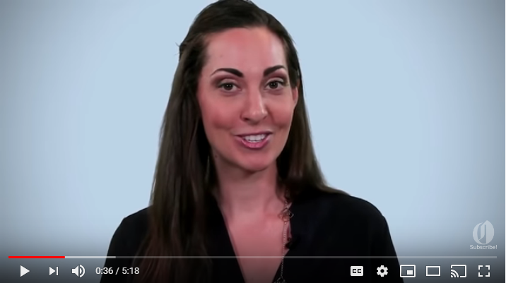
FACIAL EXPRESSIONS VIDEO

Slide 16
FOLLOW UP ACTIVITIES
DAY 2
-DELIVER YOUR SPEECH IN FRONT OF A MIRROR AT LEAST 3 TIMES
-PRACTICING YOUR DELIVERY WORKSHEET
EMAIL COMPLETED WORKSHEETS TO FACILITATOR BEFORE TOMORROW'S SESSION. FEEL FREE TO REACH OUT WITH ANY QUESTIONS!

Slide 17
DAY 3

Slide 18
PRESENTING A SPEECH RECAP

Slide 19
YOUR TURN!

Slide 20
CLOSING AND CONGRATULATIONS!

