Slide 1
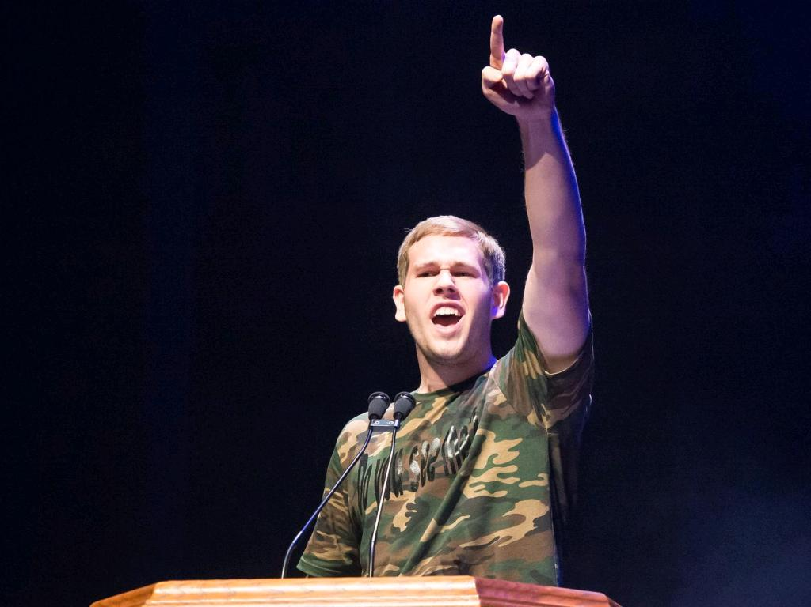
Best Buddies
Virtual Ambassador Training

Slide 2
Welcome!

Slide 3
Goals and Rules
What do you hope to accomplish today?
cc: zen! - https://www.flickr.com/photos/92671529@N00

Slide 4
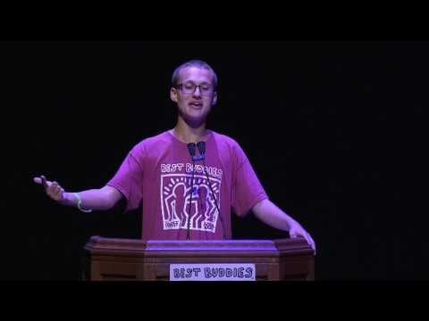
Meet Jack
https://youtu.be/iI0lmpvElGY

Slide 5
What is Self-Advocacy?
learning how to speak up for yourself
making your own decisions about your own life
learning how to get information so that you can understand things that are of interest to you
finding out who will support you in your journey
knowing your rights and responsibilities
problem solving, listening and learning, reaching out to others when you need help and friendship
learning about self-determination
Notes:
Being a self-advocate means finding your voice
Examples of when it’s important to advocate for yourself
In what ways are you a self-advocate already?
When you leave school, how/when will you advocate for yourself?

Slide 6
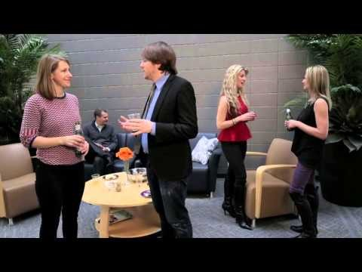
Making an Elevator Pitch

Slide 7
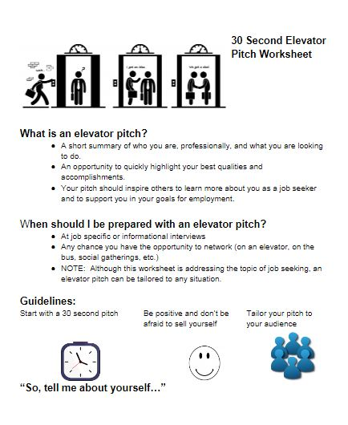

Slide 8
Day 1 Follow Up Activities
Watch for an email from Best Buddies!
What are your Self-Advocacy Goals?
What is your Elevator Pitch?
Please send us your responses BEFORE tomorrow’s session.

Slide 9
What to Expect – Day 2
Be ready to share Your Elevator Pitch
New Topics to Review:
What is an Ambassador?
What is Your Story?
Brainstorming ideas for your Ambassador Speech
SAME TIME – SAME PLACE!

