Slide 1
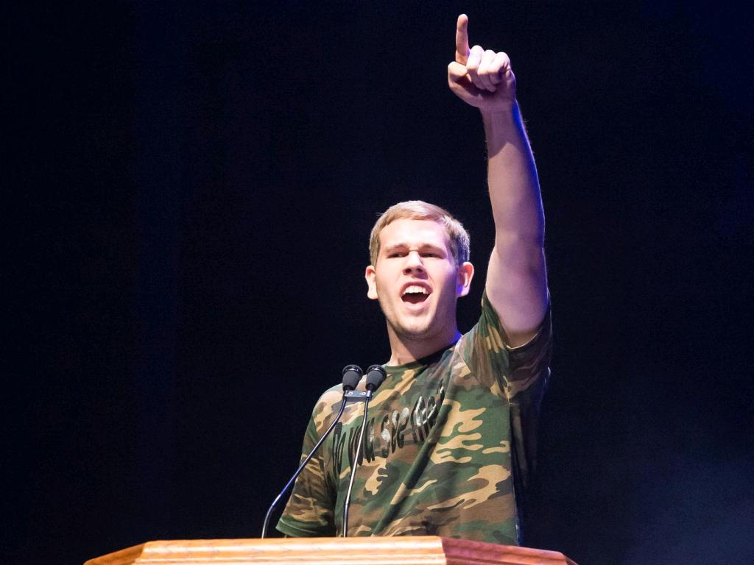
Buddy Pair Ambassador Training

Slide 2
Overview: Goals and Rules
Notes:
Overview of the training:
First section: History and Overview of Best Buddies
Second section: Sharing and articulating Best Buddies mission and your own experiences

Slide 3
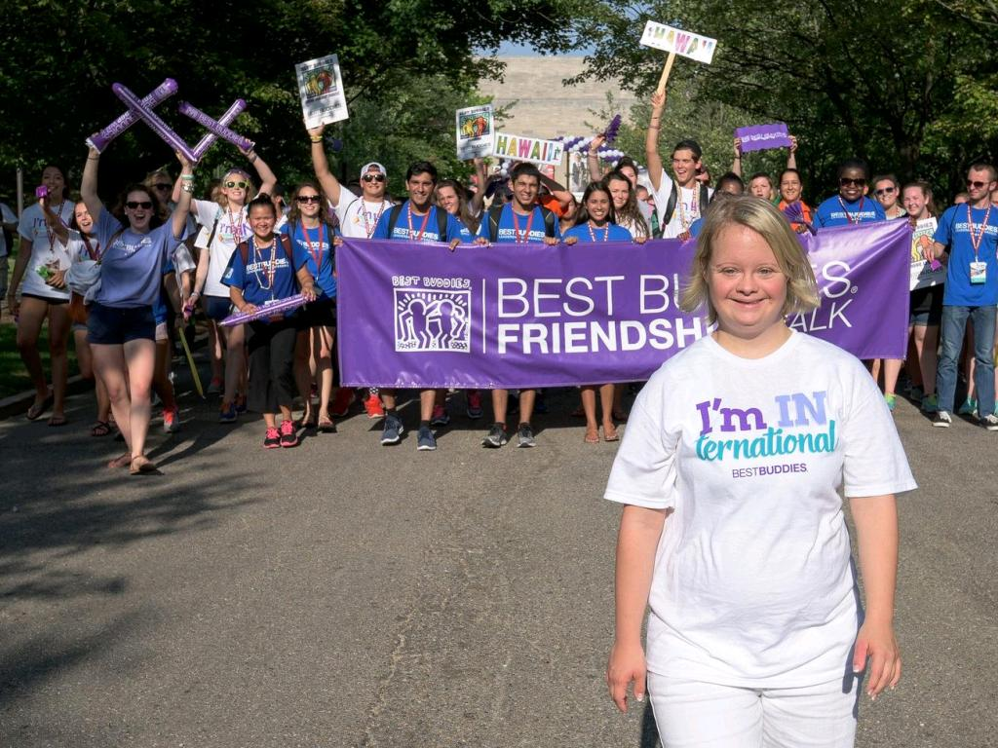
Icebreaker: Let’s talk about FRIENDSHIP!!

Slide 4
History and Pillars

Slide 5
First chapter founded at Georgetown University
Launch of Best Buddies Citizens
Launch of high school programs
Launch of e-Buddies
1987
1993
1995
1999
1989
1994
1996
Best Buddies becomes an official 501(c)(3) nonprofit organization
Launch of Best Buddies Jobs
Launch of middle school programs

Slide 6
Best Buddies has participants in all 50 states
Launch of Best Buddies Alumni Association
Best Buddies celebrates 30th Anniversary!
Launch of Best Buddies Ambassadors
2003
2011
2016
2019
2010
2012
2019
Best Buddies has programs in 50 countries around the world
Launch of Best Buddies Promoters
Launch of Best Buddies Living

Slide 7
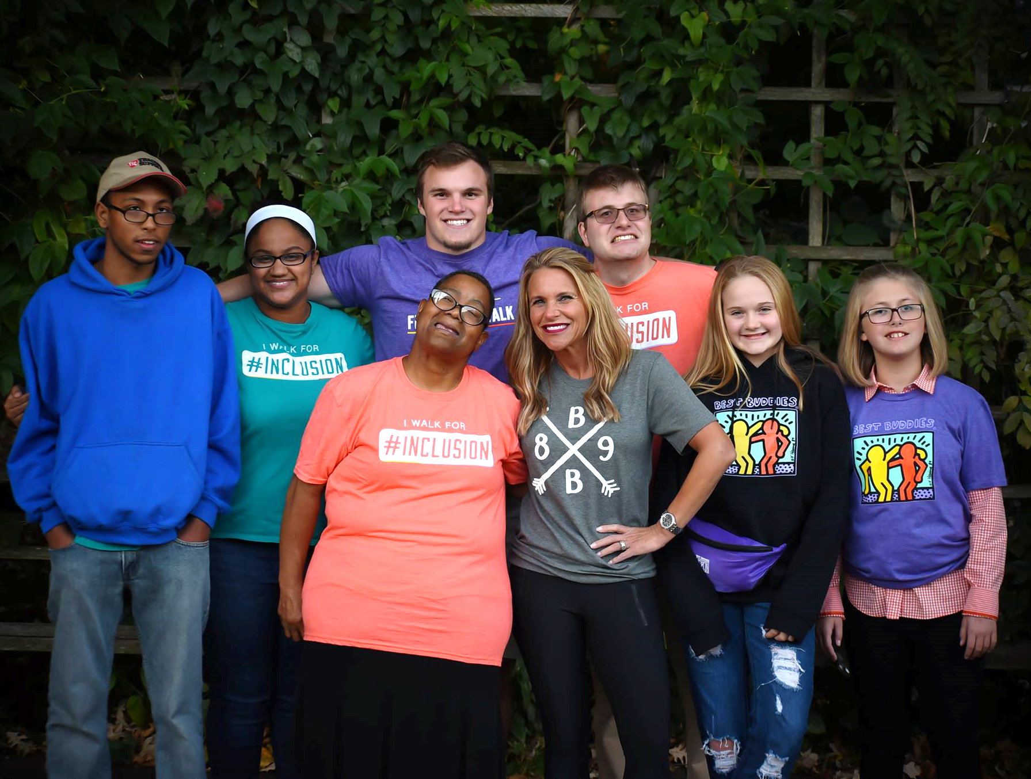
Friendship Programs
cc: Squire of Cydonia - https://www.flickr.com/photos/71917754@N04

Slide 8
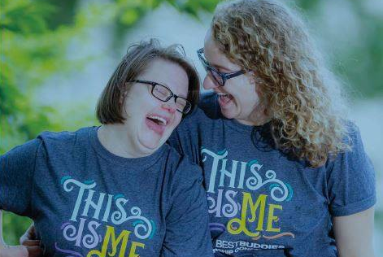
Best Buddies Friendships
Elementary Schools
Middle and High Schools
Promoters
Colleges and Citizens

Slide 9
Zach and Madeline
Buddy Pair Video Feature
Notes:
Video can be found on BBI YouTube

Slide 10
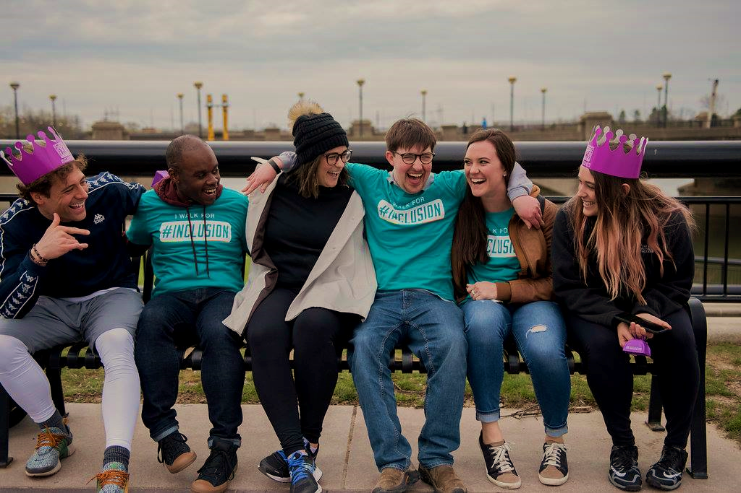
Sharing YOUR Friendship
What are some aspects of friendship that you see in the video?
What makes Zach a good friend? What makes Madeline a good friend?
In what ways to Zach and Madeline include one another?
cc: ЕленАндреа - https://www.flickr.com/photos/14901566@N07

Slide 11
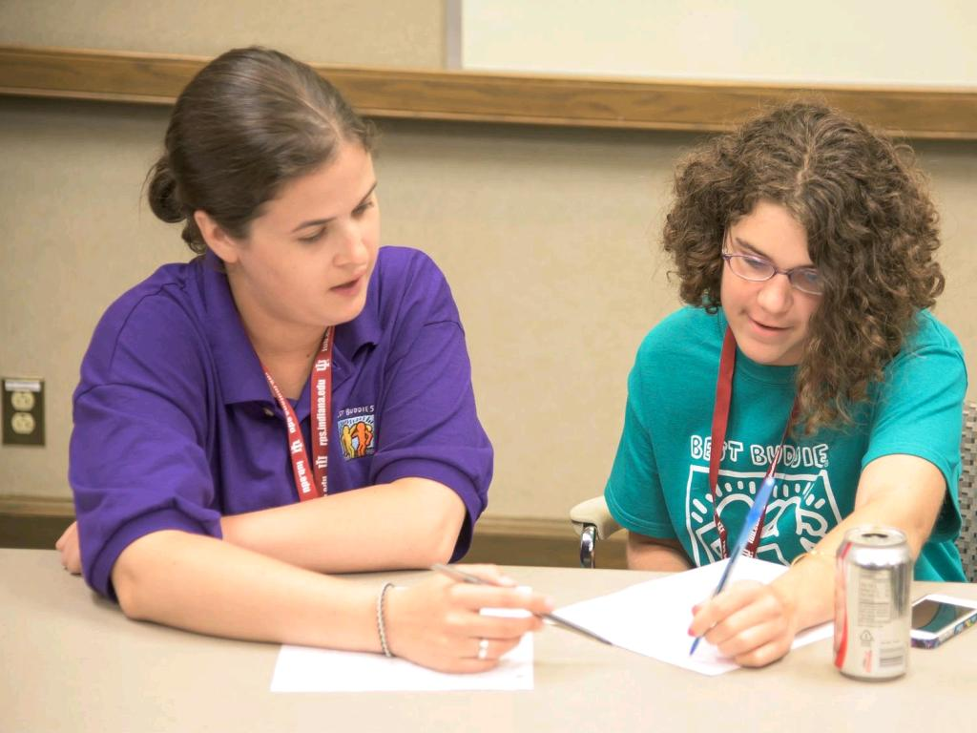
Buddy Pair Discussion
Work with your buddy to answer the questions on the Buddy Pair Bullet Points Worksheet

Slide 12
EJ and Alphanso
Buddy Pair Speech
Notes:
Video for this speech can be found on the BBI YouTube

Slide 13
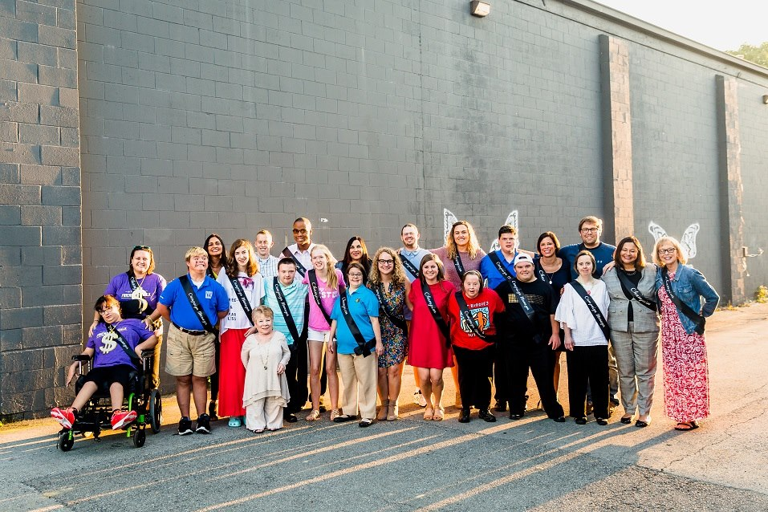
Speaking Together:
What are some things you noticed about this speech? How do EJ and Alphanso interact during their speech?

Slide 14
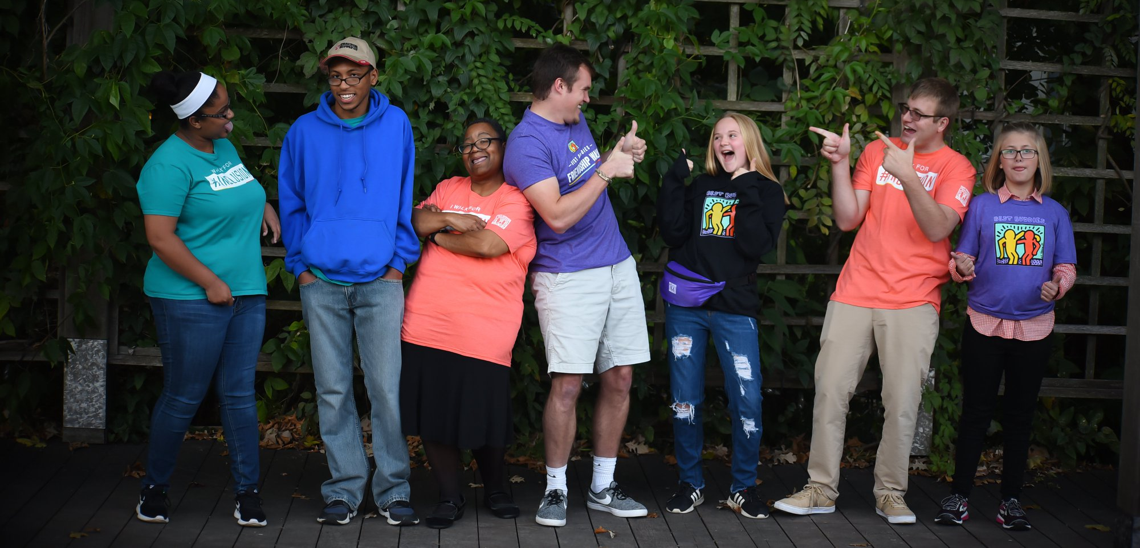
Speaking Together:
Interacting with one another during speech
Conversational—responding to one another throughout
Taking turns speaking to give audience both of their perspectives.
Having a good time! Audience gets a sneak peek into their friendship
Keep some of these things in mind as you begin writing your own speech!

Slide 15
How to Write a Speech
Intro: Who are you? What is your connection to Best Buddies and what do you want to share?
Body: What is something you want people to know about your friendship? What makes your buddy/peer buddy a good friend? What do you want people to learn from hearing about your friendship? Give examples.
Conclusion: Why should this audience care? Why is it important that they take your message and help you change the world to be a more inclusive place? What is your call to action?

Slide 16
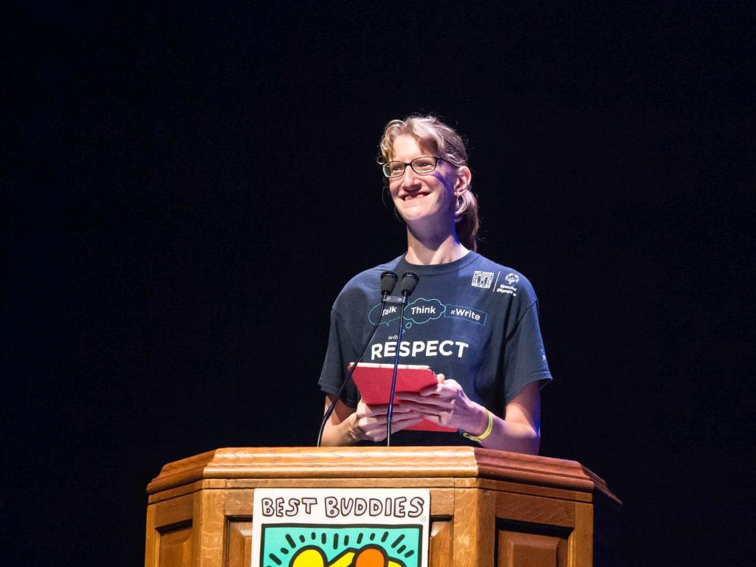
Presentations

Slide 17
Group Picture!

