Slide 1
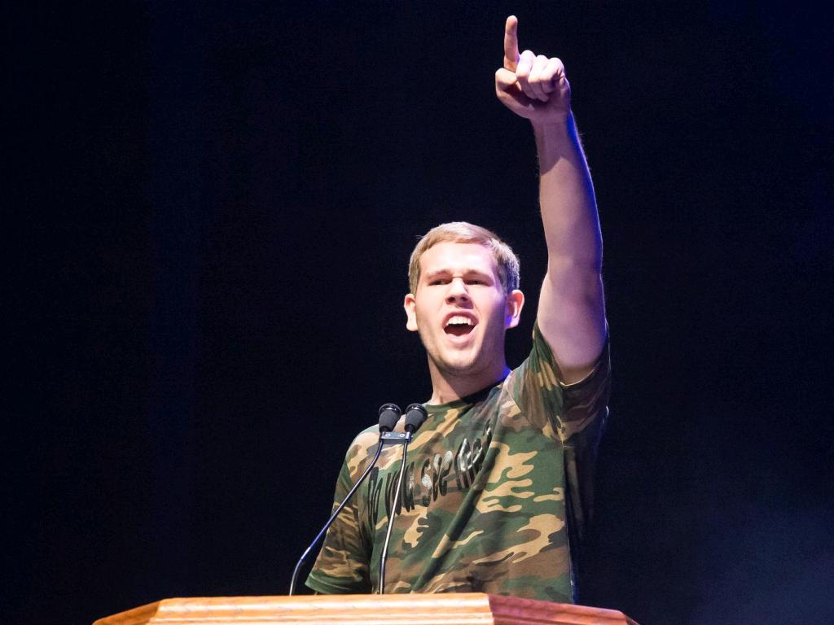
Parent Ambassadors
Best Buddies Ambassador Training

Slide 2
Training Overview
Notes:
Overview of the training:
First section: History and Overview of Best Buddies
Second section: Sharing and articulating Best Buddies mission and your own experiences

Slide 3
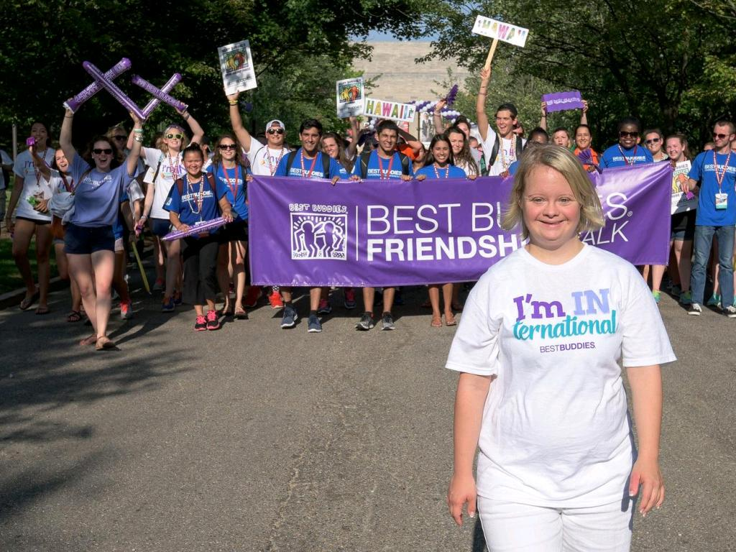
Icebreaker: Let’s Get to Know Each Other
What is your connection to Best Buddies?
(How long has your family been involved with Best Buddies, what programs are you involved in, etc.)

Slide 4
Best Buddies History

Slide 5
First chapter founded at Georgetown University
Launch of Best Buddies Citizens
Launch of high school programs
Launch of e-Buddies
1987
1993
1995
1999
1989
1994
1996
Best Buddies becomes an official 501(c)(3) nonprofit organization
Launch of Best Buddies Jobs
Launch of middle school programs

Slide 6
Best Buddies has participants in all 50 states
Launch of Best Buddies Alumni Association
Best Buddies celebrates 30th Anniversary!
Launch of Best Buddies Ambassadors
2003
2011
2016
2019
2010
2012
2019
Best Buddies has programs in 50 countries around the world
Launch of Best Buddies Promoters
Launch of Best Buddies Living

Slide 7
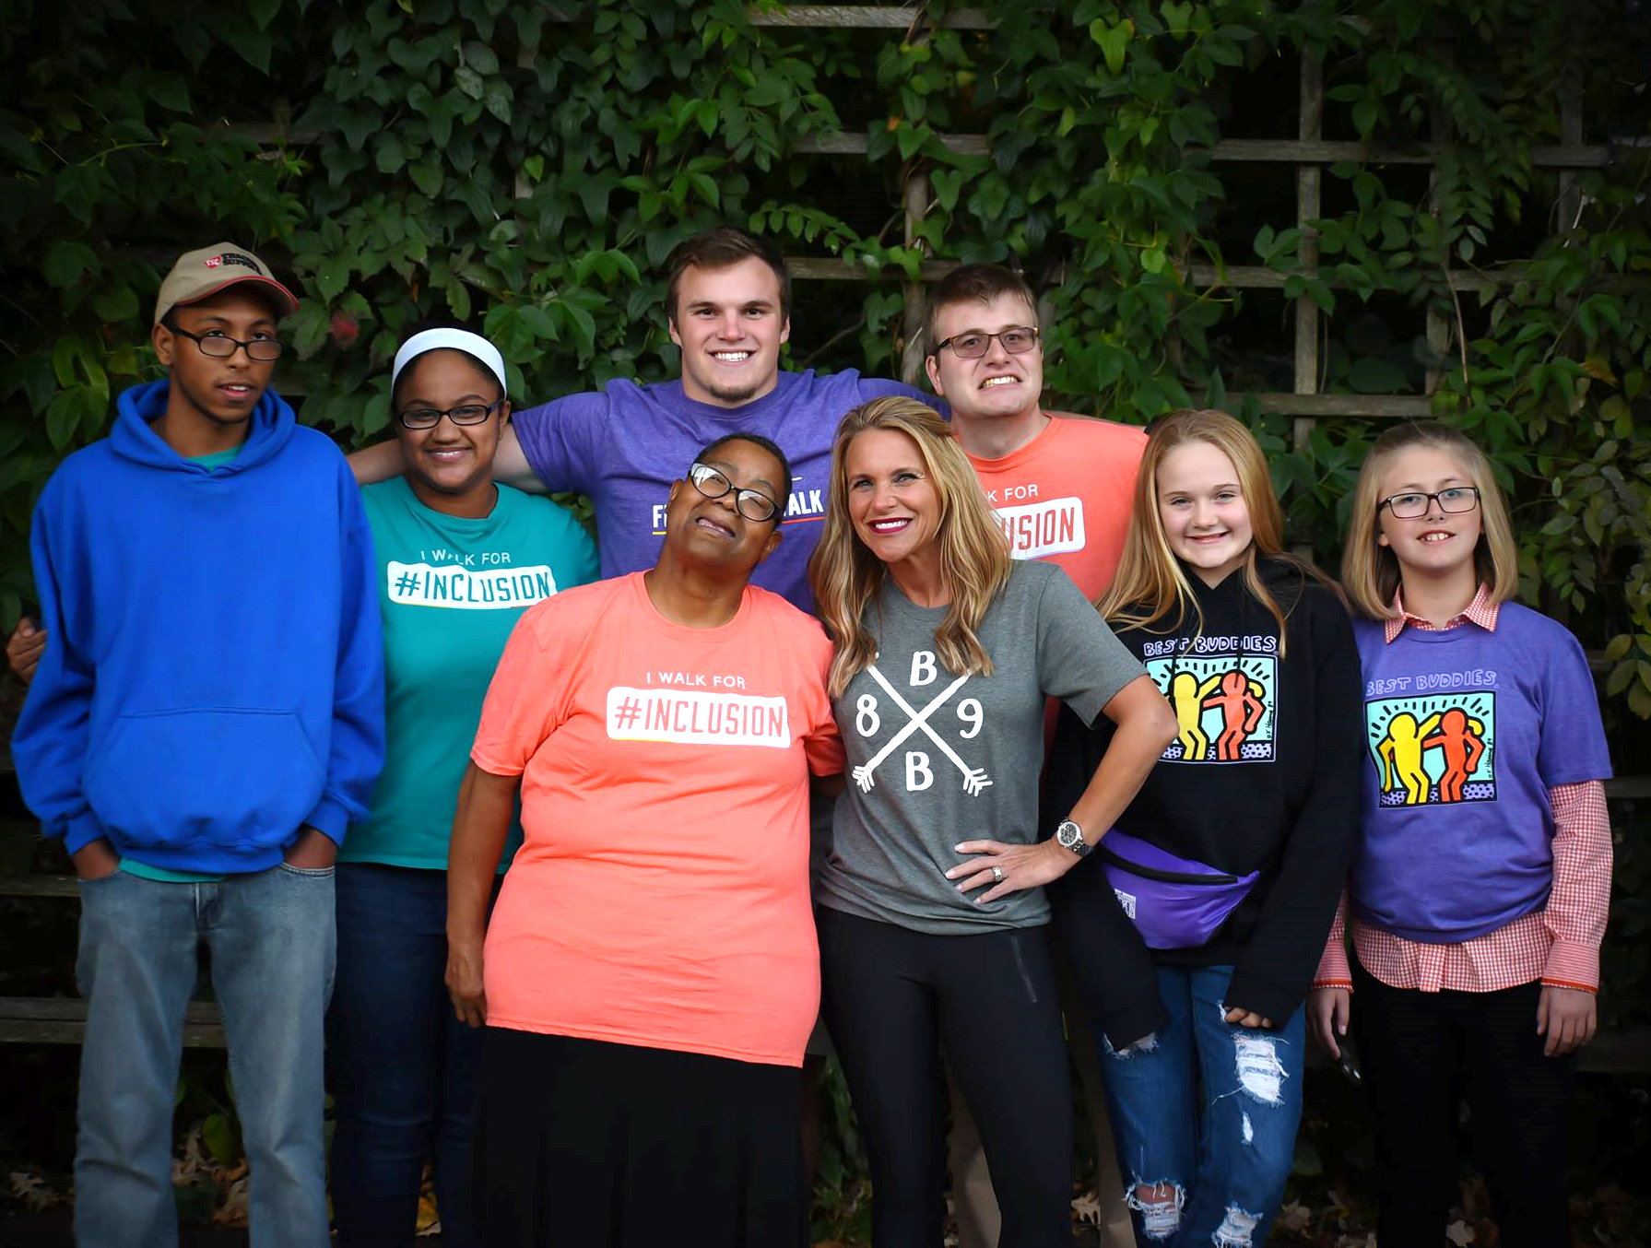
Best Buddies in Indiana
cc: Squire of Cydonia - https://www.flickr.com/photos/71917754@N04

Slide 8
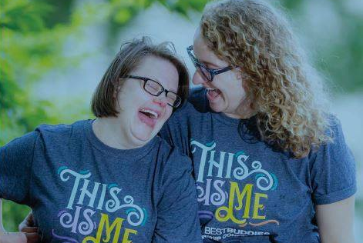
Best Buddies in Indiana
First chapter in Indiana was University of Notre Dame (1994)
State office opened in 2002
Indiana currently includes all programs with the exception of the brand-new Best Buddies Living

Slide 9
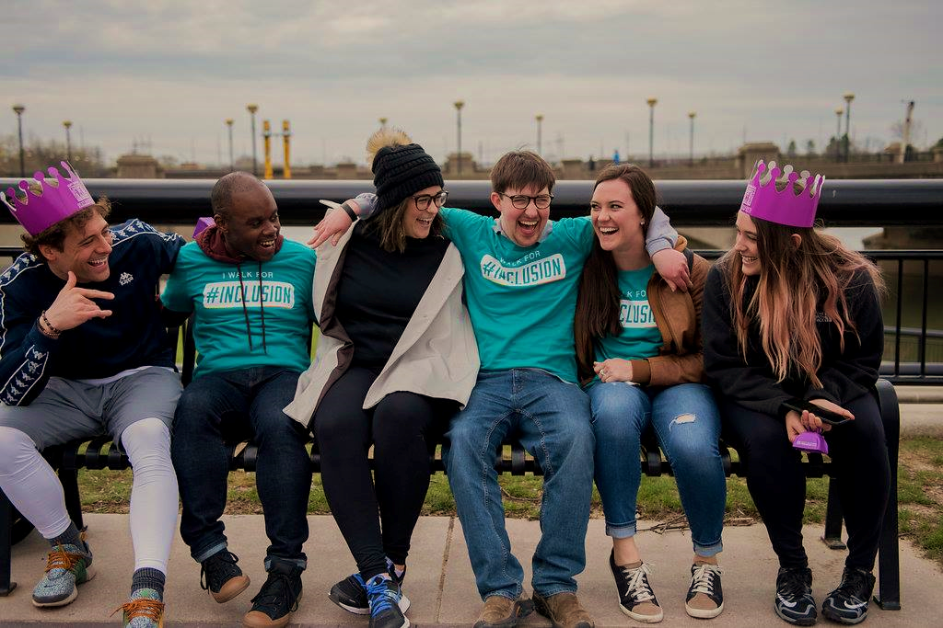
Goals
What do you want others to know about Best Buddies?
What do you hope to accomplish if you have a platform to tell people about Best Buddies?
Why are you, as a parent, such a strong advocate?
cc: ЕленАндреа - https://www.flickr.com/photos/14901566@N07

Slide 10
Best Buddies’ Mission:
“Best Buddies International is a nonprofit 501(c)(3) organization dedicated to establishing a global volunteer movement that creates opportunities for one-to-one friendships, integrated employment, leadership development, and inclusive living for individuals with intellectual and developmental disabilities.”

Slide 11
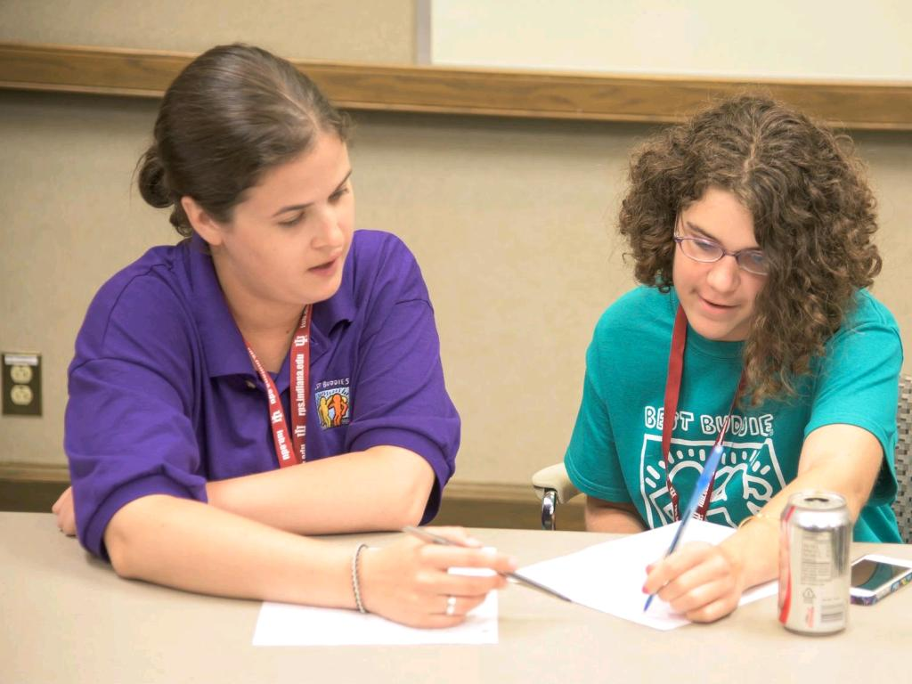
Writing a Mission Statement
As a parent, what is your mission? How does your mission as a parent overlap or coincide with Best Buddies’ mission?

Slide 12
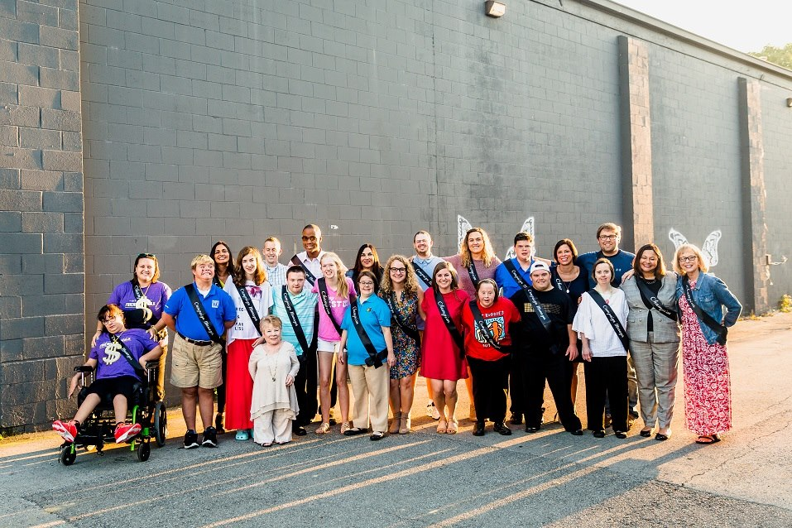
Writing Your Mission Statement:
What is your “calling, aim, ambition”?
What do you hope to accomplish in your community?
How can identifying your mission keep you on track with meeting your goal?
How can identifying your mission allow you to inform others?
What is the main piece of information you want your audience to take away?

Slide 14
Conversational advocacy
Shaping Your Message and Preparing Talking Points
Shaping Your Message and Preparing Talking Points

Slide 15
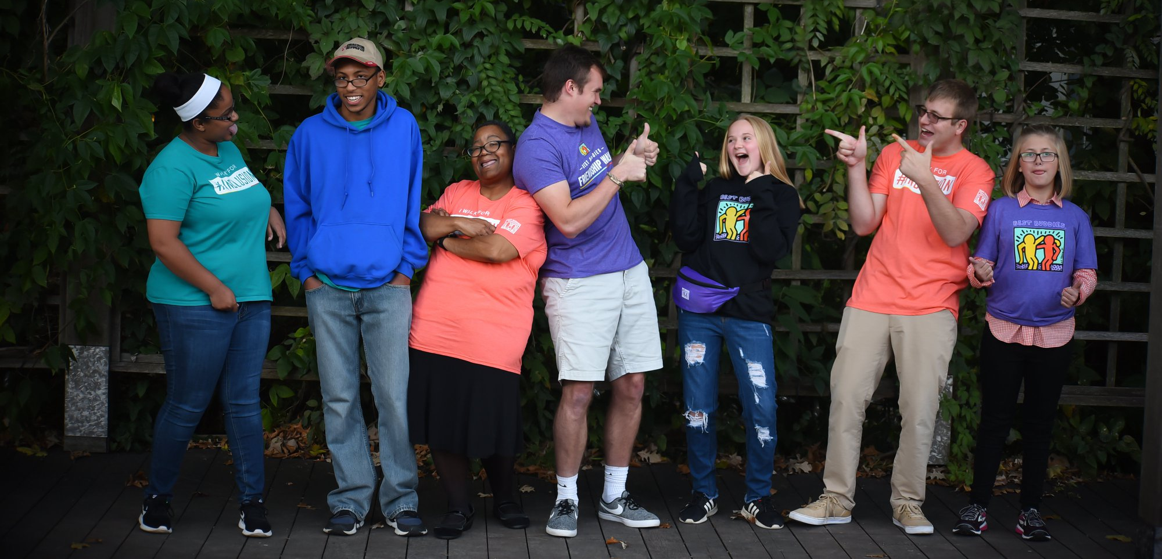
How to Write a Speech
Intro: Who are you? What is your connection to Best Buddies and why do you want to share?
Body: Share your mission. Give your audience some background information about why your mission is important—personal stories and experiences, statistics, etc.
Conclusion: Include a “call to action”—now that your audience has connected with your mission, what do you want them to do?

Slide 16
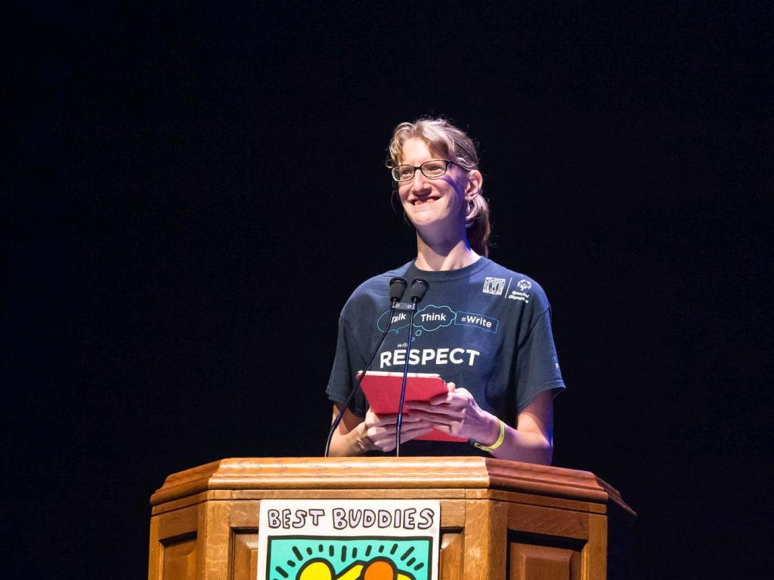
Speech Presentations

Slide 17
Group Picture!

