Slide 1

Best Buddies Jobs

Slide 2

TRANSITIONING FROM HS
Notes:
Transitioning from HS is a HUGE adjustment for everyone. There are many options for students but this can be an especially anxious time for individuals with disabilities and their families. Individuals with disabilities, in the school system, go from having monthly (or more) meetings to discuss the progress and struggles with numerous support staff to all of a sudden NOTHING, as soon as the individuals ages out.
The transition process truly begins once they enter HS and when they are considering diploma options. So the sooner you begin the conversation – THE BETTER!

Slide 3

HOW LONG CAN A STUDENT WITH AN IDD STAY IN SCHOOL?
Notes:
Did you know, it is up to each county to determine the specifics of when students with IDD “age out”. The law says that students with disabilities can stay in school until?? Take a guess… Age 22. In some counties, students with disabilities age out the day of their 22nd birthday. In other counties, students with disabilities can stay in school the entire year if their 22nd birthday is on or after the first day of school.

Slide 4
How can Best Buddies support students with disabilities after high school?
Notes:
Ask the students what options they think are available for students with IDD.

Slide 5

Best Buddies Jobs
Look what individuals with intellectual and developmental disabilities can do!
Notes:
Best Buddies Jobs is focused on securing competitive integrated employment for people with intellectual and developmental disabilities (IDD), allowing them to earn an income, pay taxes, and continuously and independently support themselves.
Share Dudley’s story (BBMA), show video via youtube… link above! (any state can use this) https://www.youtube.com/watch?v=LoZa5m1pt1E
Other organizations do what BBJ does, but we are proud of the work our participants do and the commitment of our employers. Our BBJ participants have a retention rate of 93% throughout the entire country and stays with them for as long as they are employed. We also ensures the long term success of the individual by matching them to a job that meets their skills and interests

Slide 6

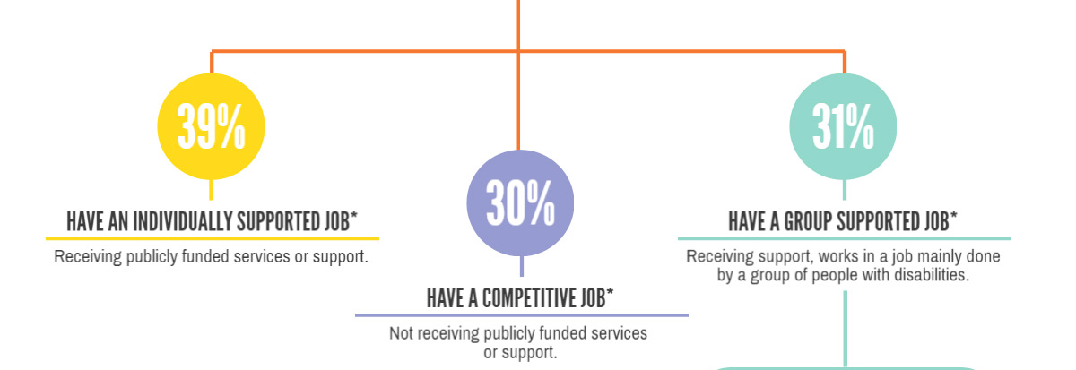
Notes:
85% of individuals with IDD do not have a paid job in the community. Our goal is to educate students and families to create a plan that works for them as they prepare to transition out of HS successfully and you can help!

Slide 7
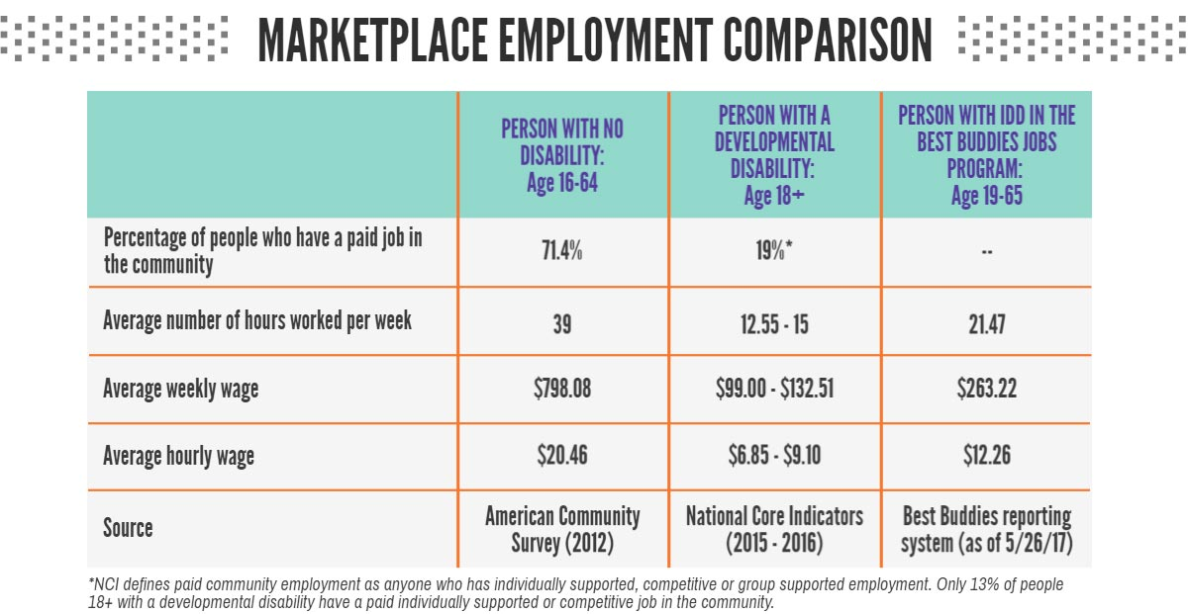
EMPLOYMENT COMPARISON
Notes:
BBJ works and we have the stats to prove it. Review the table with the students. Some questions to pose:
Do you think people with IDD want to work?

Slide 8
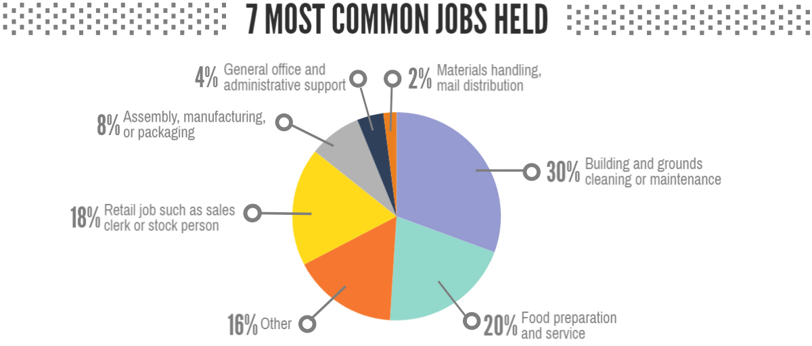

Slide 9
What can Best Buddies Jobs do for you?
Help you find a job that YOU want to do
Finding a job that’s a fit for you through job matching
Writing a resume
Applying for jobs
Prepping for an interview
Completing new hire paperwork
Travel training
Job coaching
Checking in periodically with employer and employee
Assisting with developing and achieving professional goals
Notes:
Job development: helping the individual find a job
Job placement: placing them in a job that matches their skills and interest
Job coaching: providing supplemental training , greeting tools/ support to ensure long term success

Slide 10
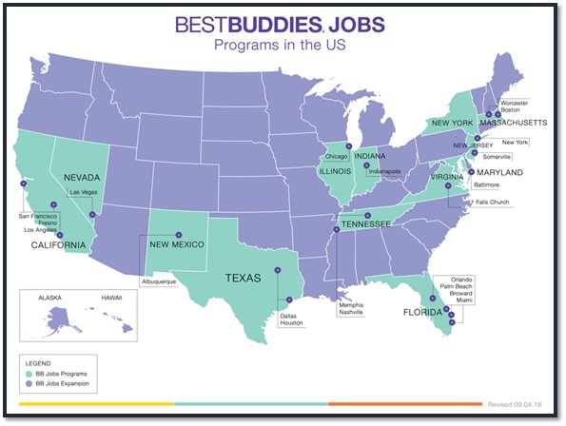
Notes:
21 OFFICES IN THE US
PLACED: 561
JOB DEVELOPMENT: 292
U.S.
Albuquerque, NM
Baltimore, MD
Boston, MA
Broward County, FL
Chicago, IL
Dallas, TX
Falls Church, VA
Fresno, CA
Houston, TX
Indianapolis, IN
Las Vegas, NV
Los Angeles, CA
Memphis, TN
Miami, FL
Nashville, TN
New York, NY
Orlando, FL
Palm Beach, FL
Somerville, NJ
San Francisco, CA
South Bay (LA), CA
Worcester, MA

Slide 11















EMPLOYER PARTNERS
Notes:
Review this to ensure all are current employer partners. Ex, removed Guess who is no longer a partner. Also, there are a lot of retail companies here; let’s see if we can find some more non-traditional employers. We should also include our national partners like TJMaxx (we have HomeGoods), Holland & Knight, Levy.

Slide 12


Slide 13

TALK TO YOUR PEERS!
Notes:
Talk to your classmates both with and without IDD about their plans after HS. Encourage them to get involved in a post-secondary program or connect with their local VR office. Just like you are preparing to leave HS, encourage the conversation with your buddy as well.

Slide 14

EDUCATE YOUR PARENTS
Notes:
Share with your parents the Jobs program and ask them if they could hire someone with IDD within their business. We are always looking to meet with new businesses to educate them on hiring people with IDD.

Slide 15

SUPPORT YOUR LOCAL WALK
Notes:
If your office currently doesn’t have the Jobs program, support your local Friendship Walk to help raise money to launch the program. Even if your area does have the program, we are looking to expand and hire additional staff members to help support more participants. Every dollar helps!

Slide 16
QUESTIONS?
Notes:
Now we would like to open it up for some safe Q & A?
Are we all feeling more comfortable, more equipped to work alongside someone who might be different from us? Are we feeling inclusive? Like we belong?
Option at this point: Pass out notecards and collect them at the end for safe anonymous questions

Slide 17

Notes:
Insert your contact information to this slide.

