Slide 1
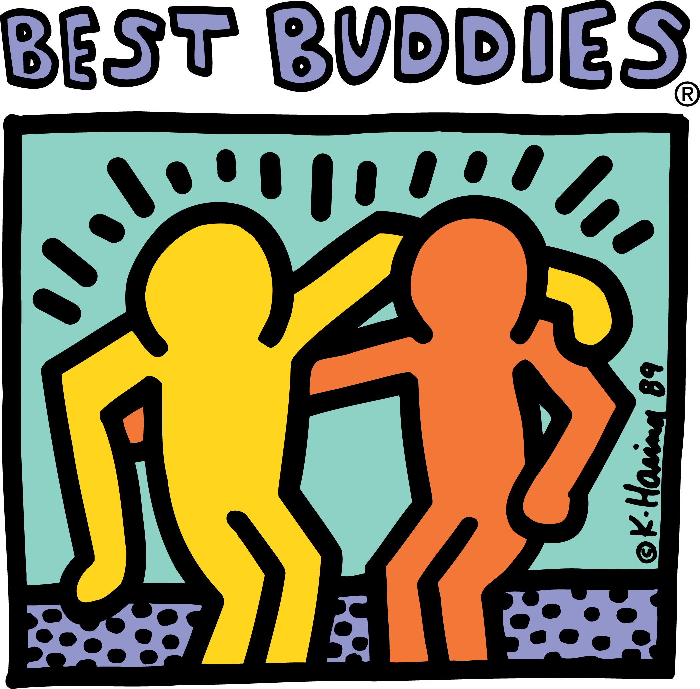
Best Buddies
Ambassador Facilitator Training

Slide 2
Best Buddies Mission Statement
Best Buddies International is a nonprofit 501(c)(3) organization dedicated to establishing a global volunteer movement that creates opportunities for one-to-one friendships, integrated employment, leadership development, and inclusive living for individuals with intellectual and developmental disabilities (IDD)

Slide 3
Best Buddies History
1987 - Anthony Kennedy Shriver founded the original Best Buddies Chapter at Georgetown University.
1989 - Incorporated as a 501(c)(3) nonprofit organization on January 19, 1989, Best Buddies® becomes America’s first national, unified, social, and recreational program for people with intellectual disabilities.
1993 - Launch of Best Buddies Citizens, with the goal of pairing adults with intellectual disabilities with their non-disabled working peers.
1994 - Best Buddies Jobs, a supported employment program targeting high-paying, corporate jobs for people with intellectual disabilities, launches in Florida, California and Massachusetts.

Slide 4
Best Buddies History
1995 - Best Buddies High Schools is established with the goal of pairing special education students in one-to-one friendships with high school volunteers.
1996 - Best Buddies Middle Schools pilot program is launched, reaching a younger age group with the hope that inclusion of people with intellectual disabilities will have a lasting effect on societal norms for the next generation.
1999 - e-Buddies® is launched as a cutting-edge e-mail friendship program.
2010 - Best Buddies expands to include programs in 50 countries!
2010 - The Eunice Kennedy Shriver Act, which authorized federal funds for Best Buddies, passed the U.S. House of Representatives on May 19, 2010.

Slide 5
Best Buddies History
2011 - Best Buddies Ambassadors becomes Best Buddies’ seventh formal program.
2012 - Best Buddies Promoters officially launches as the eighth program for the 2012-2013 school year. It becomes the first Best Buddies program open to elementary schools.
2019 - In January 2019, Best Buddies elevates its mission to meet the significant need for inclusion by establishing Best Buddies Living, a residential living experience for people with intellectual and developmental disabilities and their peers. This new program represents the organization’s newest and fourth key mission pillar, Inclusive Living.

Slide 6
One-to-One Friendship
Leadership Development
Integrated Employment
Inclusive
Living - New!
The Four Pillars of Best Buddies
Builds friendships between people with and without IDD, offering social mentoring while improving the quality of life and level of inclusion.
Educates and empowers people with and without IDD, to be leaders, public speakers and advocates.
Secures jobs for people with IDD, allowing them to earn an income, pay taxes, and support themselves.
Providing a vibrant, integrated living opportunity for people with and without IDD.

Slide 7
What is an Ambassador?

Slide 8
Best Buddies Ambassador Program
Best Buddies Ambassadors is a program that provides training for participants with and without intellectual and developmental disabilities (IDD) in areas of speech writing, public speaking, and self-advocacy.
Ambassadors develop the skills to professionally share their life stories, promote Best Buddies programs, network, and most importantly, advocate.
The Ambassadors program prepares people to become active agents of change and informed, engaging advocates for the disability rights movement.

Slide 9
Terminology
Ambassador – a participant with and without intellectual disabilities (IDD) who has completed official Best Buddies Ambassador trainings and is committed to promoting and educating audiences about the mission, philosophy, and benefits of Best Buddies through public speaking.
State Ambassador – a participant with and without IDD who has successfully completed two ambassador trainings through their state ambassadors program in one calendar year and has been selected by their state as an official state ambassador
Global Ambassador – a participant with or without IDD who has completed state and national trainings and has been invited to advocate and share their story at a national or international event on behalf of Best Buddies International. They are selected by BBI.

Slide 10
Terminology
Facilitator – Best Buddies staff person or trained volunteer who leads an ambassadors training. Volunteers can consist of board members, advisors, student leaders, or a previously trained ambassador who has been selected and approved by Best Buddies staff.
Speech Coach – a volunteer who is paired with one ambassador for the duration of an ambassadors training to assist with the writing and practicing of a speech. Speech coaches help ambassadors in areas of brainstorming, organization, and editing. Speech coaches should not be writing speeches for their matched ambassadors, but serve as a guide/mentor who provides one-on-one attention as needed.
Ambassador Liaison – a Best Buddies state staff member who has been appointed to oversee the Ambassadors program in their office or state; responsibilities include organizing ambassador trainings, managing all ambassador tracking online, recruiting new ambassadors, developing opportunities to further the experiences and professional development of current state ambassadors, and communicating regularly with the Best Buddies International Deputy Director, Ambassadors.

Slide 11
Qualities of an Ambassador
Humility: Ambassador is self-aware of their unique qualities and stays free of pride or arrogance
Professionalism: Conducts themselves in a respectful, honest and responsible way upholding the standards of BBI
Appearance: Ambassador presents themselves in a clean, well kept, and appropriate attire
Attitude: Maintains a positive perspective on their role as an ambassador and BBI
Personal Conduct: Behaves in an appropriate manner by treating people with respect, acting lawfully and showing leadership in their daily lives
Experience: Has been engaged in at least one BB program and attends ambassador trainings regularly

Slide 12
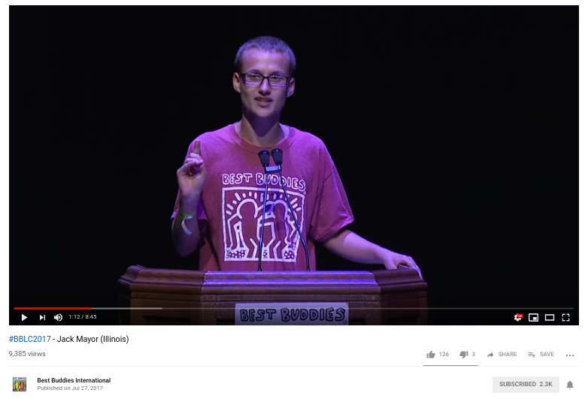
Opportunities to Speak
Best Buddies Friendship Walks
Best Buddies Leadership Conference
Best Buddies Champion of the Year Gala
Best Buddies Rides/Challenges
Chapter/Local/State Events

Slide 13
What are the benefits of self advocacy?
Notes:
Group discussion - can be used in formal and informal settings, impacts multiple layers of a person’s life, promotes independence

Slide 14
So you want to host an Ambassador training...

Slide 15
Ambassador Training Timeline
One Month Before: secure a location, determine the type of training you want to have, recruit participants and speech coaches
Two Weeks Before: secure in-kind donations, confirm and visit location,
Week of: confirm RSVPs, assign speech coaches and ambassadors, have all materials ready, secure food and equipment
Week After: sending thank you notes, get feedback, Ambassador tracking

Slide 16
Facilitator Tips
Some facilitators use a classroom on a local college campus and have a peer buddy from the college chapter book the room for free.
If you have ambassadors attending the training that have an upcoming speaking event you can have them work on the particular speech.
To utilize the skills the ambassadors have learned in your trainings provide them with a list of upcoming events in the area.
On the day of the training, don’t forget to put up Best Buddies’ signs with our recognizable logo directing participants to the room for the training.
Name tags can be helpful to the ambassadors, speech coaches and even you, the facilitator.
Having the audience give feedback to ambassadors after they present is helpful to the ambassador. A compliment sandwich is a great way to delivery feedback; one positive comment, one area for improvement, and another positive comment.

Slide 18
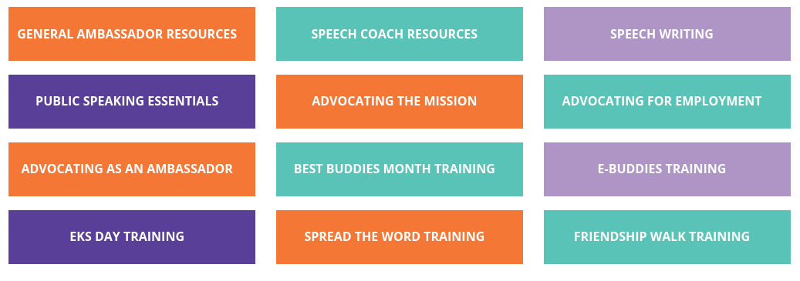
Training Topics
Speech Writing
Public Speaking Essentials
Advocating the Mission
Advocating for Employment
Advocating as an Ambassador
Best Buddies Month Training
E-Buddies Training
EKS Day Training
Spread the Word Training
Friendship Walk Training

Slide 19
Making Accommodations
Use AMB recommendation form
Start with the least amount of support and scale up as needed

Slide 20
Providing Speaking Opportunities
After your Ambassadors are trained, consider providing speaking opportunities for them to practice their skills such as:
Buddy Talks
Parent Night/Open House
Fundraisers
Community Events

Slide 21
Questions
Wrap Up
Thank You!
Notes:
Tracking, Colleges/E-buddies, Group Photo

