Slide 1


Slide 2

Leading with Intention
cc: Aron - https://unsplash.com/@aronunsplash?utm_source=haikudeck&utm_medium=referral&utm_campaign=api-credit

Slide 3
Social Role Valorization

Slide 4

The analysis of human relationships and human services. The theory is based on the idea that society tends to identify groups of people as fundamentally 'different,' and thus,of less value than everyone else.
cc: Meghan Holmes - https://unsplash.com/@yellowteapot?utm_source=haikudeck&utm_medium=referral&utm_campaign=api-credit

Slide 5
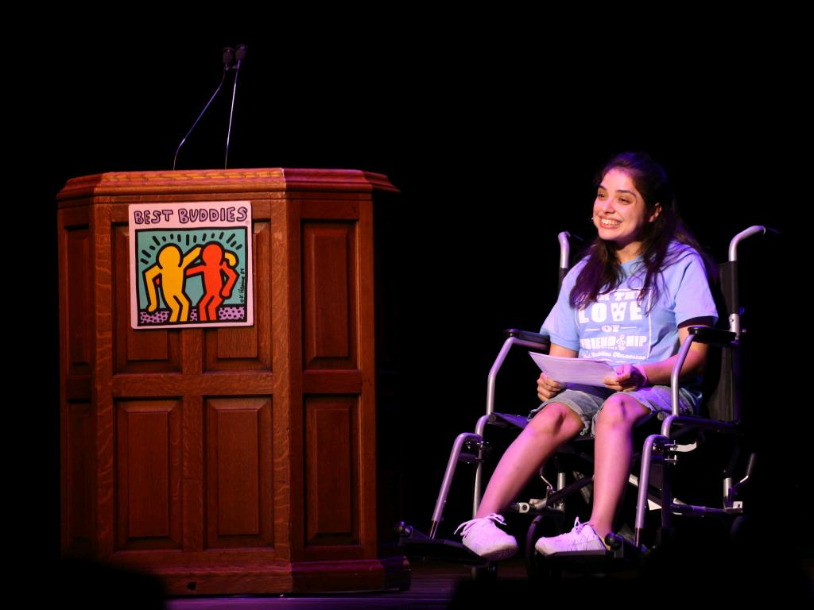
HOW DO YOU SEE THIS?
In your community? In your chapter?

Slide 6

How Does Best Buddies Fit In?

Slide 7
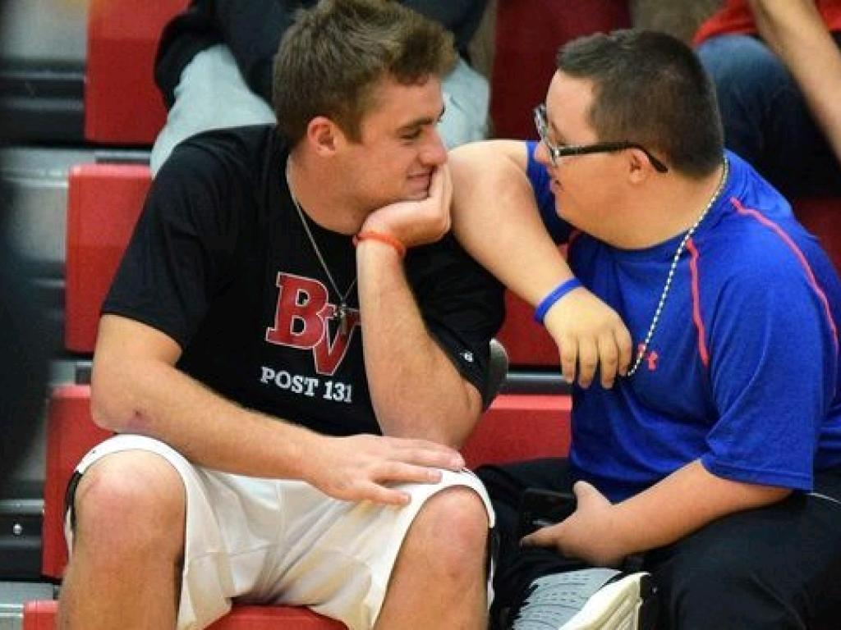
SOCIAL ROLE VALORIZATION/NORMALIZATION About creating ‘normal’ experiences Defining a set of principles to be used alongside person-centered planning to identify ‘normal’ opportunities for
LIVING
FRIENDSHIPS WORKING
RELATIONSHIPS

Slide 8
Exploration
SHARE YOUR THOUGHTS

Slide 9
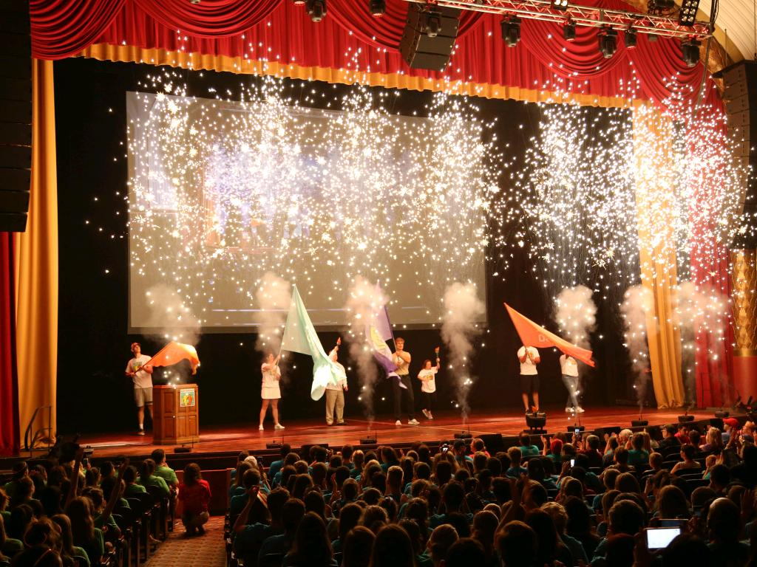
What Does our Society Value?

Slide 10

What is the Opposite?
cc: gregw - https://www.flickr.com/photos/51035602616@N01

Slide 11

This is how marginalized societies are viewed, as the values they have to offer.
cc: Isaiah Rustad - https://unsplash.com/@isaiahrustad?utm_source=haikudeck&utm_medium=referral&utm_campaign=api-credit

Slide 12
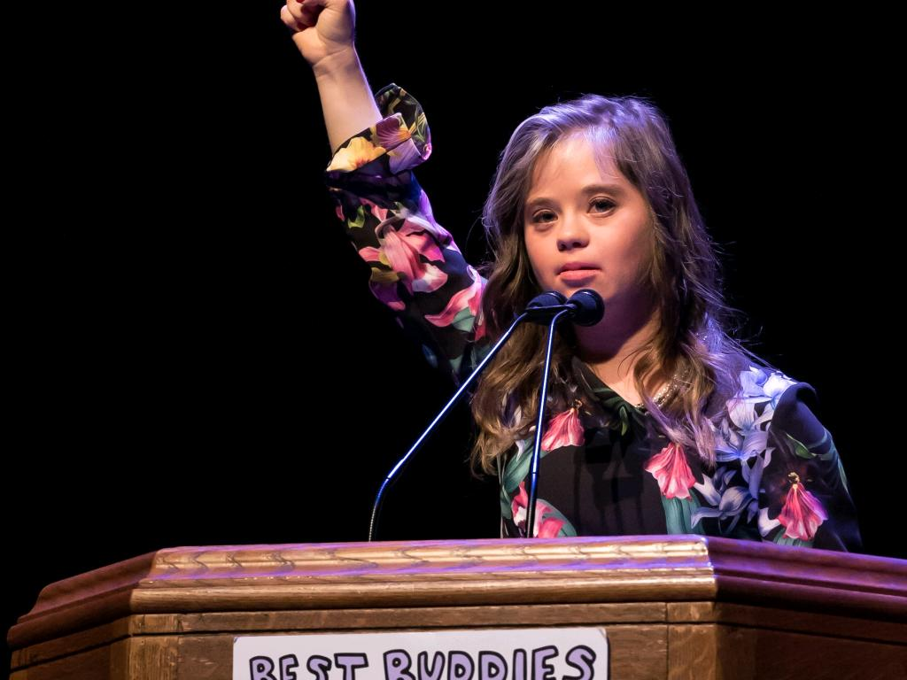
The Work to Be Done .

Slide 13
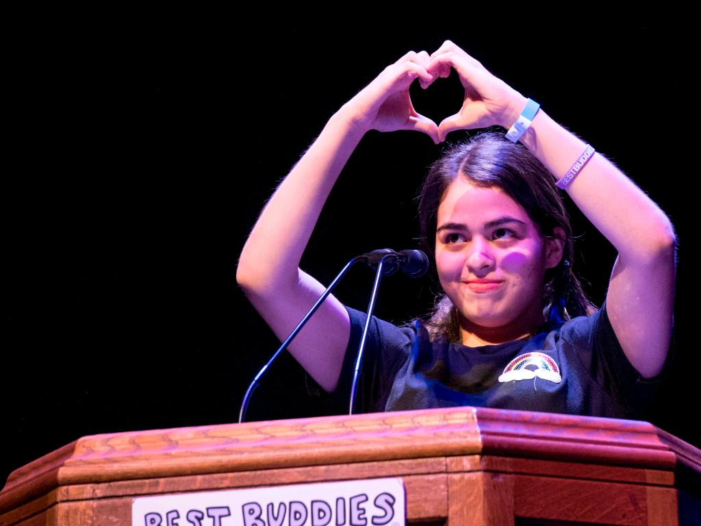
What Can
We Do?
As Advocates & Allies

Slide 14
This vs. That
Group Exercise

Slide 15
Intent vs. Impact:
YOUR INTENTIONS DO NOT DETERMINE OR EXCUSE YOUR IMPACT

Slide 16
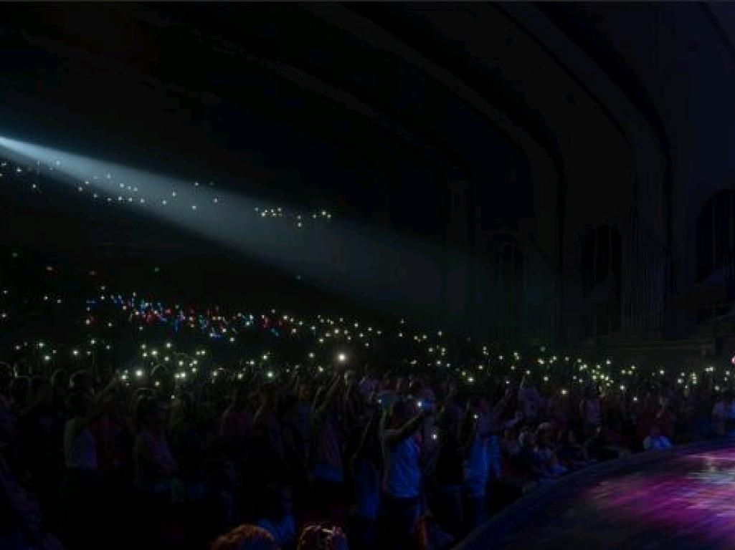
Intent: what we wanted to happen Impact: what actually happened

Slide 17
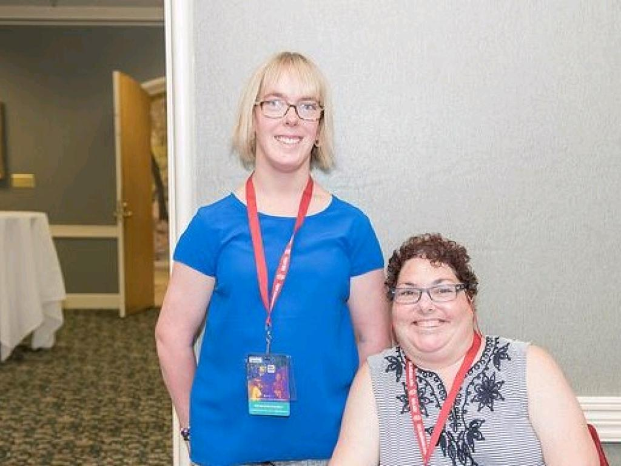
Equality: Everyone is treated the same
Equity: Everyone is treated in a way that meets their individual needs

Slide 18
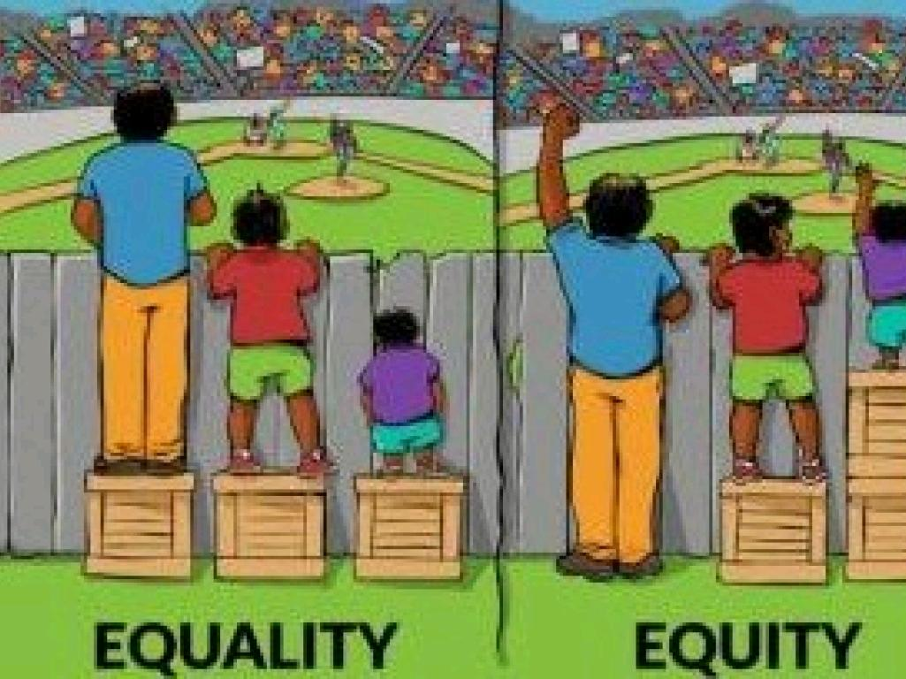

Slide 19

Examples of Equality
Everyone uses the stairs
Everyone pays their own way
When it is important to promote equality?
cc: Leo Reynolds - https://www.flickr.com/photos/49968232@N00

Slide 20

Examples of Equity
Some people can use a ramp
Events are planned in such a way that allows all club members to access them
cc: Matt Artz - https://unsplash.com/@mattartz?utm_source=haikudeck&utm_medium=referral&utm_campaign=api-credit

Slide 21
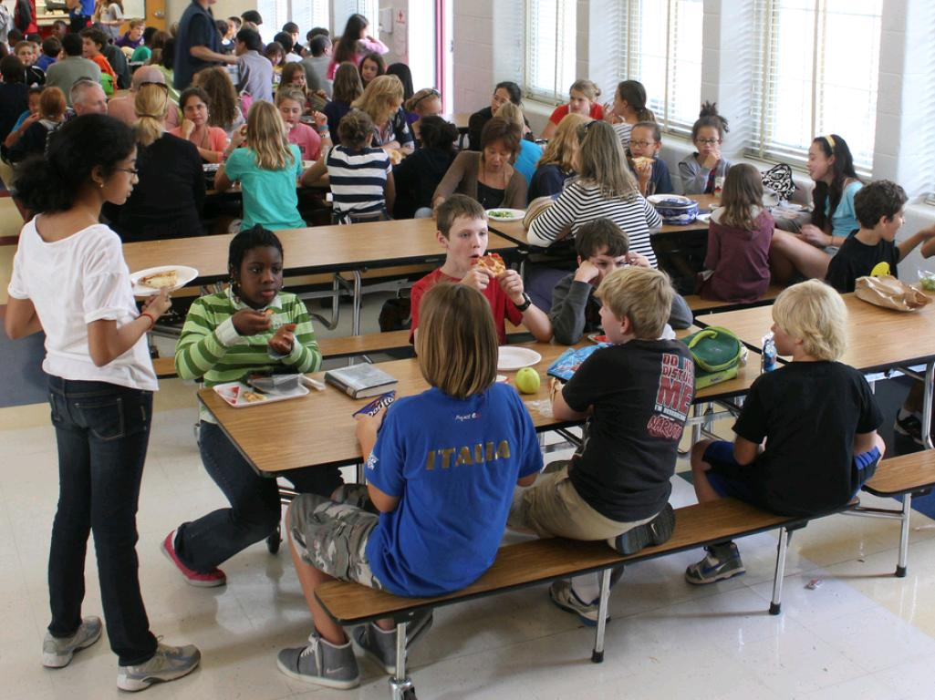
Passive Inclusion v. Active Inclusion Having a seat at the table v. being part of the conversation
cc: woodleywonderworks - https://www.flickr.com/photos/73645804@N00

Slide 22
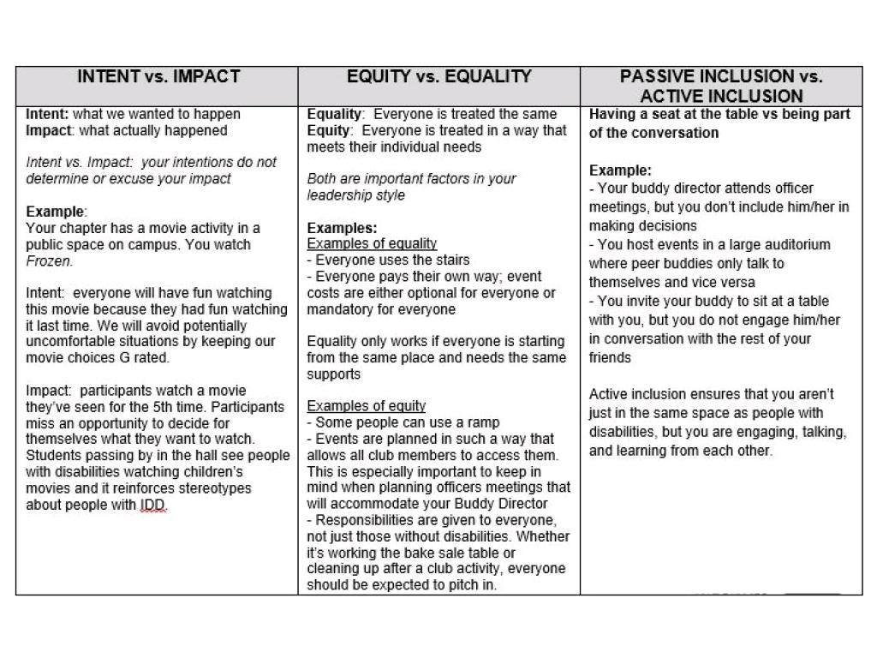

Slide 23
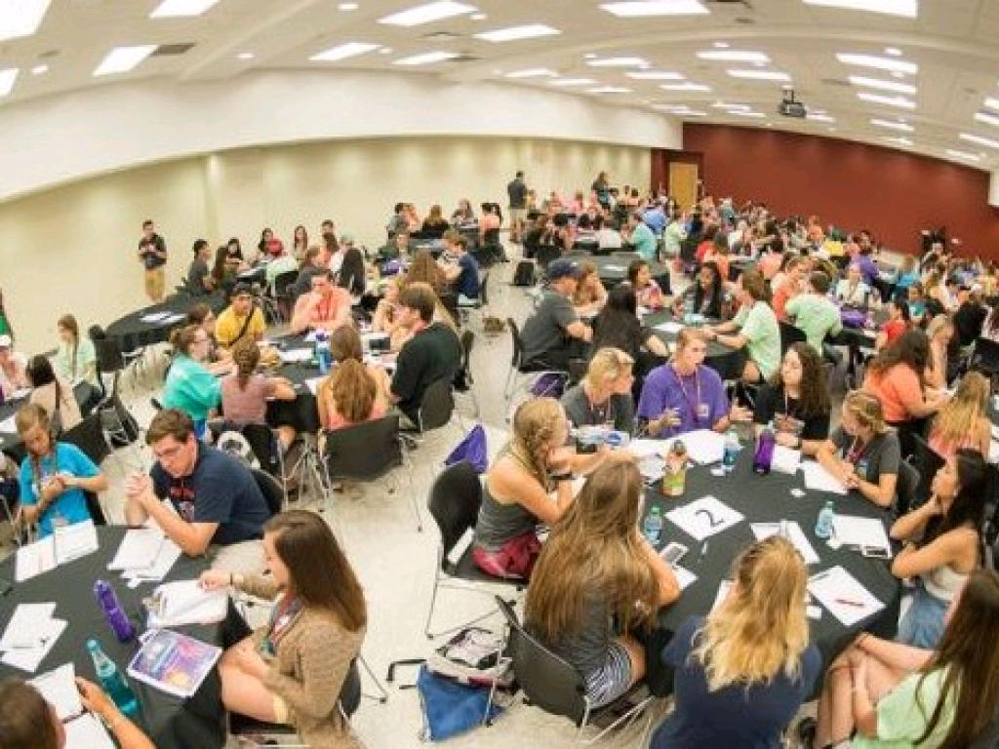
BREAKOUT Group one: Intent vs. Impact Group two: Equality vs. Equity Group three: Passive Inclusion vs. Active Inclusion

Slide 24
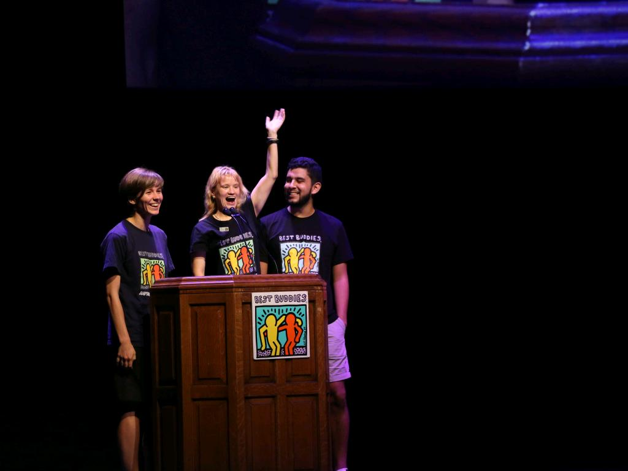
SHARE

Slide 25
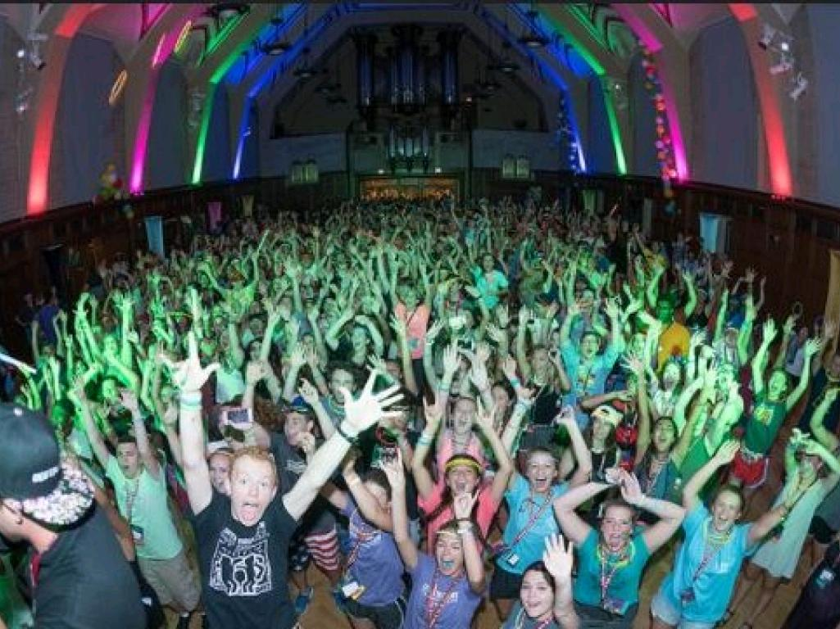
Be mindful of the messages you’re sending people at your school and in your community who are not familiar with Best Buddies. You have the power to shape others’ perceptions of people with disabilities.

